Slide 1

Project Update: Claims/Clinical Linkage Project
MHDO Board of Directors
June 6, 2013

Slide 2
Topics To Be Covered
Part I (Joint)
  Introductions-MHDO
  Exchange Update-HIN
  Findings from The Clinical/Claims Data Matching Project-MHDO/HIN
Part II (HIN)
  HealthInfoNet Data Use and Release Policy

Slide 3
Introduction of the Project
MHDO and HIN entered into a contract in the fall of 2012 to determine the technical challenges and initial match rates of linking de-identified claims data from the APCD with the identified HIE data.
MHDO provided HIN with twelve months of commercial claims data (restricted data set which includes date of birth and member zip code).
HIN received a grant from MeHAF to support the expense associated with the project.
HIN contracted with a vendor, Arcadia Solutions, to conduct the technical linkage of claims and clinical data by matching unique patients across the claims and clinical data sets and where possible matching distinct episodes of care and encounters from the from the clinical data set with distinct claims in the claims data set.
Conclusions:
Technically we can do the linkage with the data we collect today however the confidence level and the match rate of the linkage would be higher if we were linking an identified claims data set with an identified clinical data set.
The public policy discussion needs to address:
  The collection and release of identified data to allow providers to more effectively improve care for their patients
  Define the role of MHDO in collecting data other than what is required by rule to collect today (including clinical data) and linking it with administrative data already collected.

Slide 4
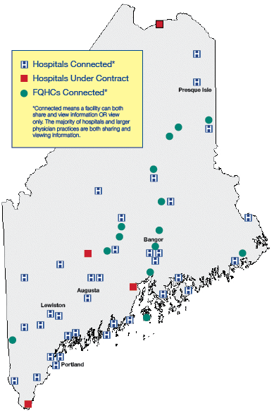
HIE Connections
Hospitals, FQHCs, Ambulatory
34 of 38 hospitals connected
All Maine Hospitals under
Contract to HIN
15 FQHCs
376 Ambulatory sites
including physician practices
behavioral health and long
term care
4

Slide 5
HealthInfoNet’s HIE Operating Statistics As of April 31, 2013
1,207,509 individuals have a HealthInfoNet record (84% of Maine’s resident population)
13,122 individuals have opted out (1%)
7,409 Maine clinicians and support staff have active HealthInfoNet user accounts
3,109,365 inbound messages are received by HealthInfoNet each week
The HealthInfoNet Central Data Repository (CDR) is 1.454 TB in size and is growing at 3 GB a day

Slide 6
Data Categories Managed in HIN Today
Patient Identifier and Demographics, including insurer
Encounter History
Laboratory and Microbiology Results
Radiology Reports
Adverse Reactions/Allergies
Prescription Medication History
Diagnosis/Conditions/Problems (primary and secondary)
Immunizations
Vital Signs
Dictated/Transcribed Documents
Continuity of Care Documents (CCD)

Slide 7
Findings from the MHDO/ HealthInfoNet
Clinical and Claims
Data Matching Project

Slide 8
Description of the Project
A proof of concept project to evaluate the technical feasibility and effectiveness of matching de-identified commercial claims data from the MHDO All Payer Claims Database (APCD) with clinical data managed within HealthInfoNet’s statewide database on an event of care basis
Demonstrate the percentage of linkage achieved
Identify problem areas that may need to be explored to achieve optimum linkage
Consider the value of combined databases

Slide 9
Project Parameters
Data sets included de-identified commercial claims data and clinical data for the period July 1, 2011 to June 1 2012
Claims data included payer-specific member IDs and indirect member identifiers, date of birth, zip code, gender and encrypted Social Security Number (when available)

Slide 10
Clinical Data

Slide 11
Matching Approach Logic

Slide 12
The Opportunity

Slide 13
Matching Methodology and Results
Methodology
Member/person matching using limited demographics
Event of care matching using demographics and date of service
Procedure code validation
Member/person matching using history of events of care
Frequency matching
Provider matching on history of events of care
Results
Of 645K Member IDs, 379K (55%) were not matched
Demographic and event of care matching found a significant match for 264K (41%)

Slide 14
Implications and Next Steps
Considering the limitations of the data – 41% is a VERY high match rate!
  2012 Clinical data excluded many providers around the state
  2012 Claims data excluded public payers and uninsured
Validation: The single best thing we can do is confirm the results.
Additional Data Elements will likely result in 90+% match:
  Provider identifiers
  More Data: Longer timespan for richer event histories
Next Steps
HIN and MHDO review technical strategies for collaboration – Enterprise Master Provider and Patient Indices' (EMPI)
Continued work with the PHI Subcommittee on Policy issues
  Release of PHI
  Integration of clinical and claims data

Slide 15
HealthInfoNet Data Use
and Release Policy
15

Slide 16
Process for Data Use and Release
Policy Development
Based Upon Participant Agreement Provisions
Incorporation of relevant HIPAA and MHDO Data Access & Use Rules
Review by legal counsel, HIN staff, & consultants
Two reviews by HIN Technical and Professional Practice Advisory Committee (TPAAC- 2/6/13 recommendation to adopt)
Preliminary review with HIN Board of Directors – 1/16/13
Presentation to HIN Data Advisory Committee – 3/13/13
Adopted By HIN Board of Directors – 3/20/13
Patient Communication Plan – Consumer Advisory Committee
16

Slide 17
Data Request Categories
Participant request for clinical data for treatment and/or operations purposes
Participant request for meeting reporting requirements
Request by Participant for providing clinical data to patients via PHR
Request for utilization data authorized as public
Request by a non-Participant for provider specific data not considered public
17

Slide 18
Notification and Approval Requirements
No Requirement
  Provider requests for patients with treatment relationship
  De-identified data considered publicly available
Notification Only (data supplier may opt-out)
  Providing access to clinical data to patient
  De-identified aggregated data
Notification and Approval (data supplier must op-in)
  Person or provider identified data without treatment relationship
  Request by non-provider for provider/patient specific data
18

