Slide 1

MHDO Board Retreat
July 16, 2015

Slide 2
Agenda
  Past Year Accomplishments and Key Deliverables for Next 12 Months
  20 minutes
  CompareMaine
  Quality Data Measures
  Medical Episode Grouping Procedures
  Development Website
  Communication Strategy
  1 hour and 45 minutes

Slide 3
Past Year Accomplishments and Next Year’s Deliverables
Recap of the Past Year
Review of key deliverables for next 12 months

Slide 4
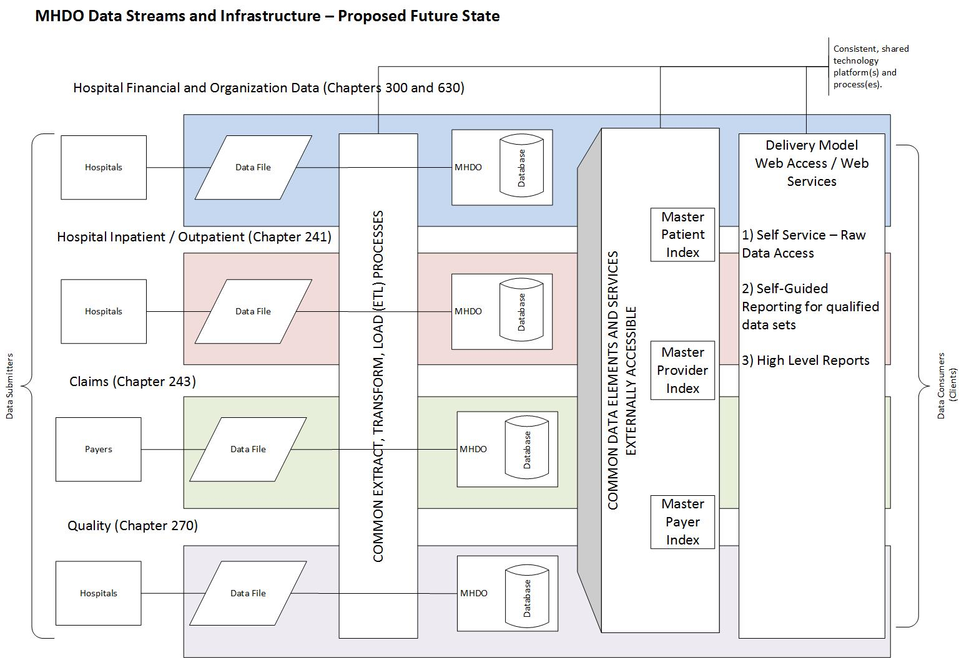

Slide 5
Recap of the Past Year
Collaboration and Coordination with Stakeholders
  Held 1 meeting with Payer User Group
  Held 6 meetings with Data User Group
  Held 4 meetings with Consumer Advisory Group, 2 future meetings planned before September 30
  Established Hospital Data Submitter Group and held first meeting
Data Warehouse Modeling
  Implemented MHDO Assigned Member Number enhancements
  Improved the provider matching process by relying on NPI
  Improved the identification of duplicate records
  Developed strategy for structural, reference, administrative, and behavioral metadata and began work based on work plan.
  Updated APCD Data Dictionaries and enhanced utility (21 dictionaries)

Slide 6
Recap of the Past Year
Data Release
  Enhanced documentation included with the APCD Quarterly data releases including: claims to eligibility match, PMPM, validation, and payer activation/deactivation reporting as well as observations reported in the external QC process and by payers
  Established a formal external QC of APCD data
  Released three APCD Quarterly Releases
  Implemented formal compliance strategy for hospital data
  Developed preliminary timeline, requirements and mockups for a new data request tool
  Developed an interim data request tracking tool and weekly team meeting to review data requests
Data Submission Portal Enhancements
  Completed annual payer registration updates via the portal
  Improved Portal usability for payers, MHDO, HSRI, NORC users
  Implemented Chapter 243 changes in production
  Implemented and performed annual validation update process

Slide 7
Recap of the Past Year
Inpatient and Outpatient Hospital Encounter Data
  Documented current hospital data processing procedures and responsibilities
  Working directly with hospitals to address issues with data submissions for 2012-2014
  Surveyed Hospitals to establish new baseline re the identification of hospitals and provider based clinics
  Identified the limitations with the current data submission tool
  Identified requirements and design of the new submission portal
  Held webinar with hospital data submitters to provide an overview of plans for new submission system
Research and Recommendations on Subscription Model and Self-Service Access Options
  Began tracking ad hoc analytic requests to assess user needs
  Identified potential self-service beta testers
  Developed a phased approach for access to the MHDO APCD via the NORC Data Enclave
  External QC parties will begin doing work in the NORC Data Enclave

Slide 8
Recap of the Past Year
Design and Launch of New CompareMaine Site
  Developed site name, branding, sketches, content strategy, development site and refine display
  Finalized list of over 300 procedures and 200 facilities for consideration in the site
  Developed nuanced methodology tailored to each CPT code category
  Enhanced provider attribution and groupings
  Recommended three categories of quality data (patient experience of care, Healthcare-associated infections, surgical complications)
  Developed recommendation for episode grouper software
  Developed cost output data and distributed for external review by facilities and payers that will be impacted

Slide 9
Recap of the Past Year
Update to MONAHRQ 5.0 with 2012 Hospital Inpatient Data
  Successfully loaded and vetted data with stakeholders in version 5.0 MONAHRQ test site
  Worked with AHRQ and MONAHRQ staff to ensure version 5.0 accessibility
  Prepared for OIT deployment certification for a July launch
  Beta tested version 6.0 with AHRQ and provided feedback on the integration of claims data
Rule Making
  Drafted new Chapter 120 data release rule
  Began process for proposed changes to Chapter 243 and 241

Slide 10
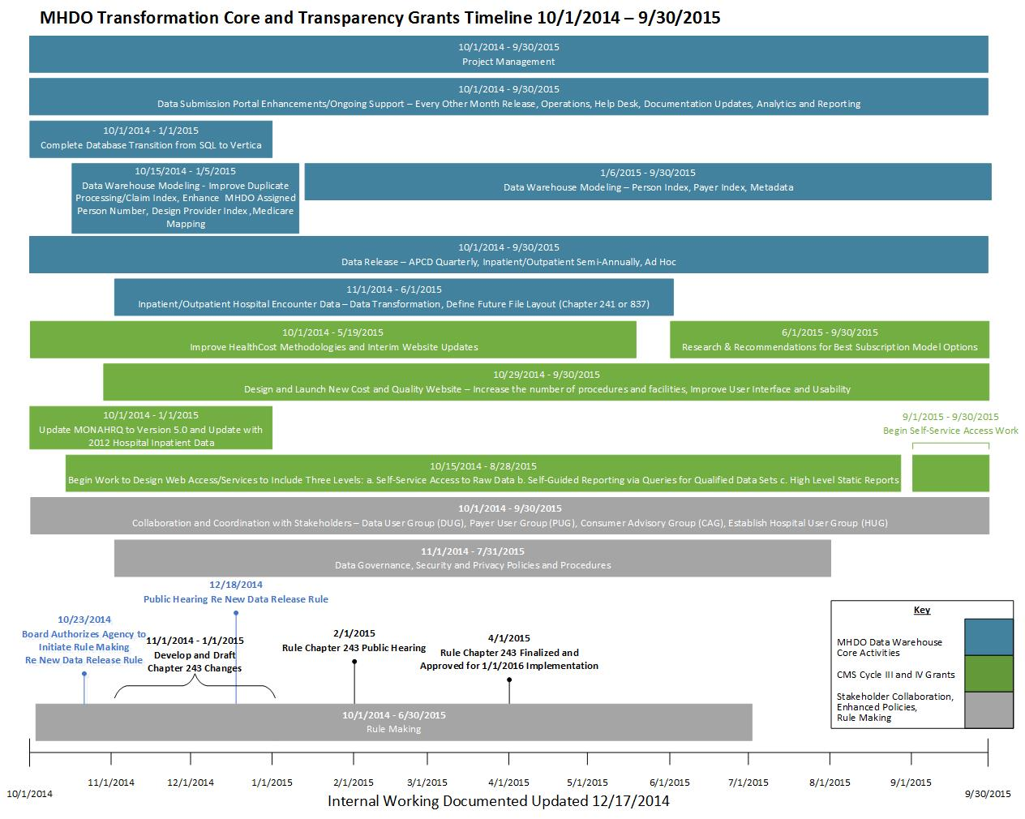

Slide 11
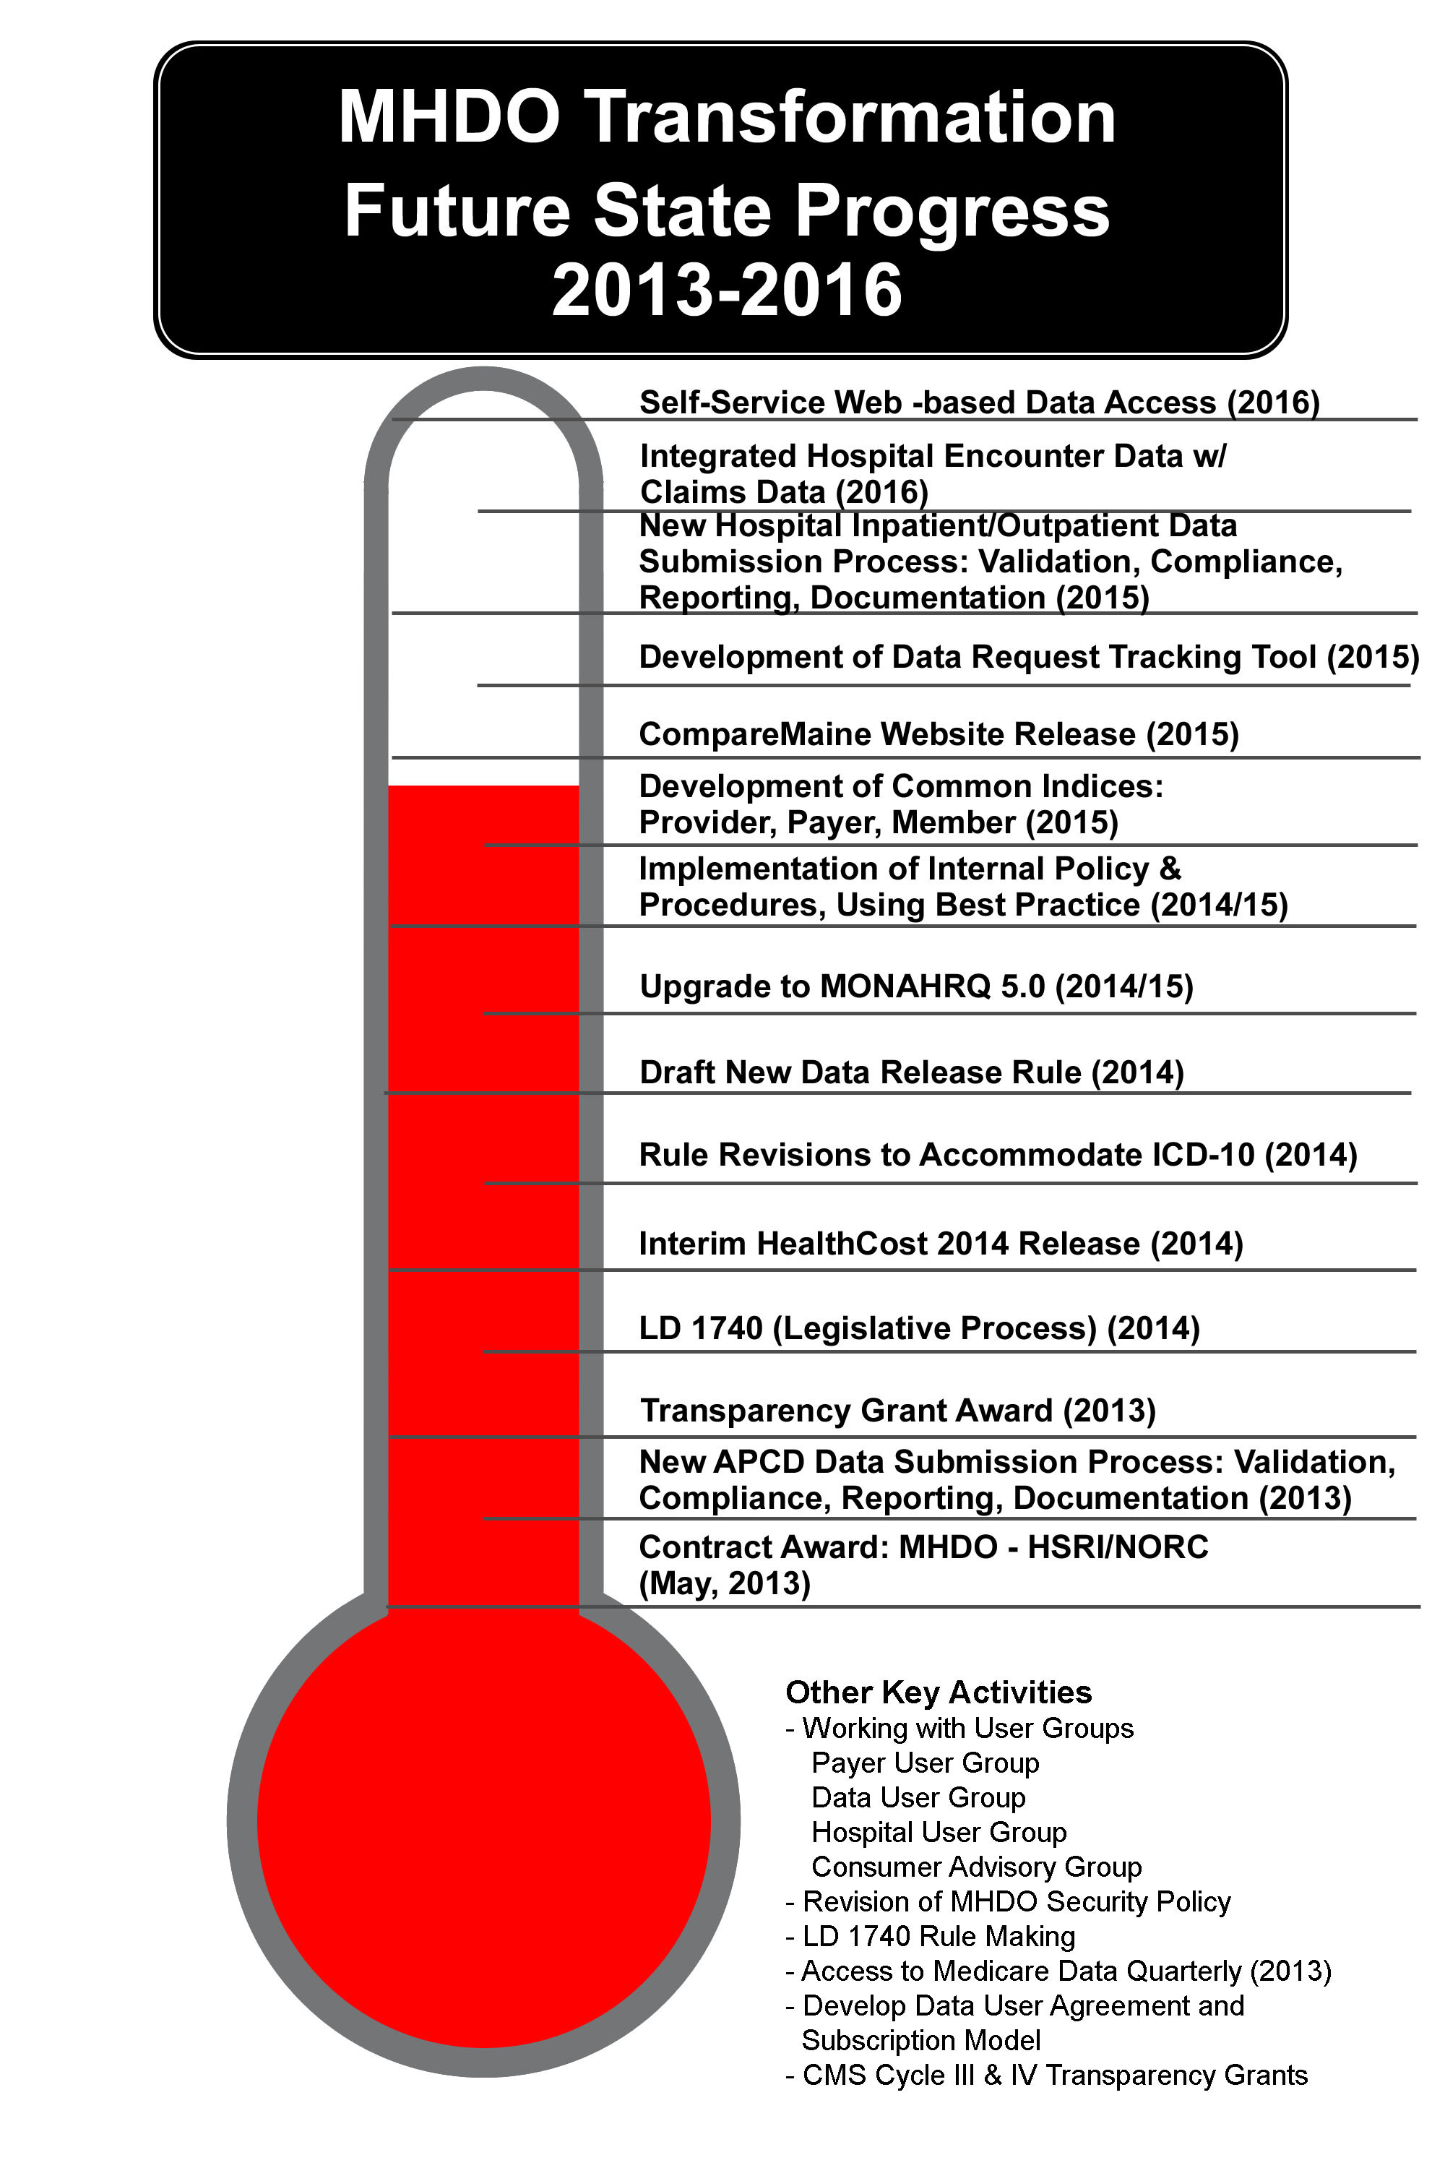

Slide 12
Key Deliverables for Next 12 Months
Release CompareMaine (September 2015)
Board approval of Chapter 120 (December 2015); Submit proposed rule to Legislature January 2016
Design and Implement New Hospital Data Submission Portal (July 2016)
Resolve Historical Issues with Hospital Data (2010-2014)
Release MONAHRQ 6.0 (TBD-dependent on status of hospital inpatient data)

Slide 13
Key Deliverables for Next 12 Months
MHDO Data Warehouse Portal (APCD)
  Implement ICD-10 Validations
  Implement Chapter 243 Changes
  Data Release
  Develop automated Data Request Tool, including New Data Request Form and Data Use Agreement, for Request Tracking and Processing
  Address issues with historical hospital data (2010-2014)
  Process and Release hospital data through current 2015
  Establish Release timeline beginning with 2015 hospital data
  CompareMaine
  September Launch, including Webinar for Key Stakeholders
  Update with Additional Procedures, Providers, User Interfaces
  Quarterly Data Updates

Slide 14
Key Deliverables for Next 12 Months
Hospital Inpatient/Outpatient Encounter Data
  Develop, test and launch new submission portal
  Develop set of data submission validations and thresholds
  Transition historical Hospital Data to Vertica
  Subscription Model and Self-Service Access
  Pilot Test Enclave Access for QC Work
  Develop Procedures for Data Users to Access Enclave for Data Analysis
  Collaboration and Coordination with Stakeholders
  Continue to Work User Groups: Data User Group (DUG), Consumer Advisory Group (CAG),
  Payer User Group (PUG), Hospital User Group (HUG)

Slide 15
Planning the Next 12 Months
MHDO, HSRI and NORC will hold their annual strategy and planning meeting this fall to review priorities and develop a work plan for the coming 12 months.

Slide 16

CompareMaine
Review quality measures and distribution of Maine facilities on scale
  Board Approval of the quality measures to include in CompareMaine
  Review Feedback from Consumer Advisory Group regarding the two word icon displays
  Board Approval of the display
Review of internal work with the MEG
  Board Approval of the MEG and the strategy of September release
Present CompareMaine development website to board
Communication strategy regarding new website

Slide 17
Quality Data Measures
Quality measures
Data Display

Slide 18

Issues Raised at the June Meeting
State and national comparisons
Statistical methods used for developing ratings

Slide 19
Summary of Quality Ratings
Refer to Quality Measure Ranking Summary spreadsheet

Slide 20

Board Discussion and Vote
Quality Measures

Slide 21
MHDO Board Approved Displays for Testing
The following slides show the two displays approved by the Board during the June meeting

Slide 22
 | Overall Patient Experience Rating | Serious Complications | Healthcare-Associated Infections
Facility Name 123 Avenue Street City, State 12345
Facility Name 123 Avenue Street City, State 12345
Facility Name 123 Avenue Street City, State 12345
Much Above Average
Average
Average
Much Above Average
Above
Average
Below Average
Above
Average
Average
Much Below
Average

Slide 23
 | Overall Patient Experience Rating | Serious Complications | Healthcare-Associated Infections
Facility Name 123 Avenue Street City, State 12345
Facility Name 123 Avenue Street City, State 12345
Facility Name 123 Avenue Street City, State 12345
Much Above Average
Average
Average
Much Above Average
Much Above Average
Much Above Average
Much Below Average
Much Below Average
Average

Slide 27
Summary of Display Feedback from Consumer Advisory Group
The word “Average” is not very meaningful to a consumer.
Without meaningful words, better to use a symbol without any words.
Shape colors are not bright enough, interested in bold colors like red, yellow, green.
The shapes were not a meaningful representation of quality.
Cell phone bars were better, easy to understand that more bars are better.
Overall interest in seeing the actual rates and percentages.
Confusing when a higher rate equals a lower score (Higher HAI rate = less bars).

Slide 28
Board Discussion and Vote
Data Display

Slide 29
Medical Episode Grouping Procedures
Review Work to Date
Proposed procedures for September Release

Slide 30
Methodology
The MEG uses clinically based logic to create groupings of claims, and adjusts the cost estimate by severity of the condition.
The average episode cost represents the total cost of the procedure and related diagnostic exams, follow-up exams, and other related services in the 30 day period before and after the main procedure.
The episodes are filtered to remove claims from public payers and for individuals 65 years old or older.

Slide 31
Review Procedures
Refer to Grouper Procedure spreadsheet

Slide 32
Future
Additional surgical procedures will be evaluated for inclusion in future iterations of the website after the initial September launch

Slide 33
Board Discussion and Vote
Medical Episode Grouping Procedures for September Release

Slide 34
Development Website
Review Current Display
Content Development and Language Review

Slide 35
Communication Strategy
Identify Key Stakeholders

Slide 36
Planned Communication
Held Webinar for Health Plans and Providers to Kick-off Data Review for Procedures Costs (June 2015)
Notify Governor's Office (early September 2015)
Notify HHS, IFS Committees (early September 2015)
Notify CMS (early September 2015)
Webinar for Key Stakeholders (mid September 2015)
Press Release (late September 2015)
Public launch of CompareMaine (September 30, 2015)

Slide 37
Board Discussion
Communication Strategy

