Slide 1

MHDO Board Meeting
June 4, 2015

Slide 2
Agenda
Section 1: What are we already publicly reporting?
10 minutes
Section 2: Why are we integrating Healthcare Cost and Quality information?
15 minutes
Section 3: CompareMaine Plan for September Release
60 minutes
Next Steps
5 minutes

Slide 3
Section 1:
What are we already publicly reporting?
Cost Information
  HealthCost
Quality Information
  MONAHRQ 2.0.4
  Patient Experience Matters
  Annual Healthcare Associated Infections Report
  MQF Hospital Utilization/Variation Reporting

Slide 4
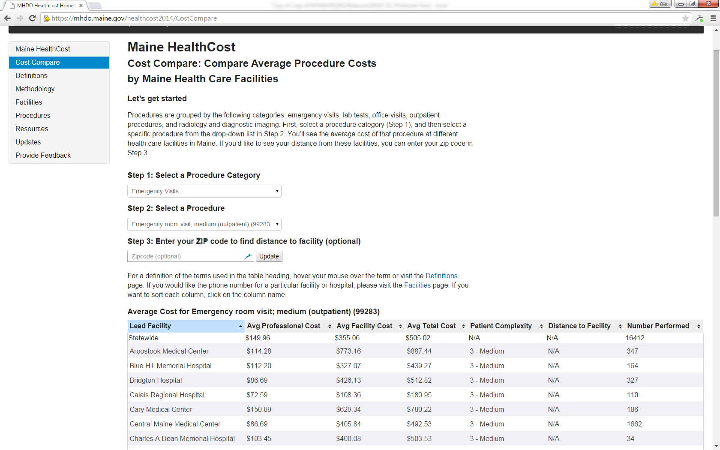
HealthCost 2014

Slide 5
Summary of MONAHRQ
MONAHRQ 2.0.4 (Current Site)
  Avoidable Stay Maps
  Hospital Utilization Reports (Including Mean Cost)
  County Rates
  Hospital Quality Data Topics Include:
    Childbirth
    Death and readmissions
    Heart attack and heart failure
    Heart surgeries and procedures
    Patient experiences
    Pneumonia
    Stroke
    Surgical Patient Safety
    Other Patient Safety
    Other
MONAHRQ 5.2
All of MONAHRQ 2.0.4 plus:
  Compatible with May 2014 Hospital Compare Data
  Improved Website Interface
  Hospital Profile Pages
  CMS Provider Cost Data
  Additional Quality Topics:
    Emergency Department
    Imaging
    Infections
    Nursing Care
    Patient Survey Results
    Prevention and Treatment
    Summary Scores
    Surgeries

Slide 6
Review of Data in MONAHRQ
 | # of Measures |  | Notes
Topic | V 2.0.4 | V 5.2
Childbirth | 7 | 7
Communication | 7 | 6
Death and Readmission | 19 | 18 | 1 measure dropped
ED Treat and Release | 0 | 4 | Pending data analysis
Emergency Throughput | 0 | 7
Environment | 2 | 2
Heart attack and chest pain | 6 | 8 | 3 measures dropped
Heart failure | 4 | 3 | 1 measure dropped
Heart surgery and procedures | 4 | 4
Imaging | 0 | 5
Infections | 2 | 6
Other surgeries | 5 | 5
Patient safety | 5 | 5
Pneumonia | 6 | 2 | 4 measures dropped
Prevention and Treatment | 0 | 1
Satisfaction Overall | 2 | 2
Stroke | 1 | 1
Summary Scores | 0 | 3
Surgical Patient Safety | 15 | 17 | 2 measures dropped
Total | 85 | 106
Data on MONAHRQ is displayed by 36 Maine hospitals and by county using rates and word icons on hospital quality, utilization, cost, and avoidable stays.
Data Sources Include:
  MHDO’s Inpatient Hospital Discharge Data
  Medicare Provider Charge Data
  CMS Hospital Compare
  Agency for Healthcare Research & Quality (AHRQ) Quality Indicators (populated with MHDO Inpatient Data)

Slide 7
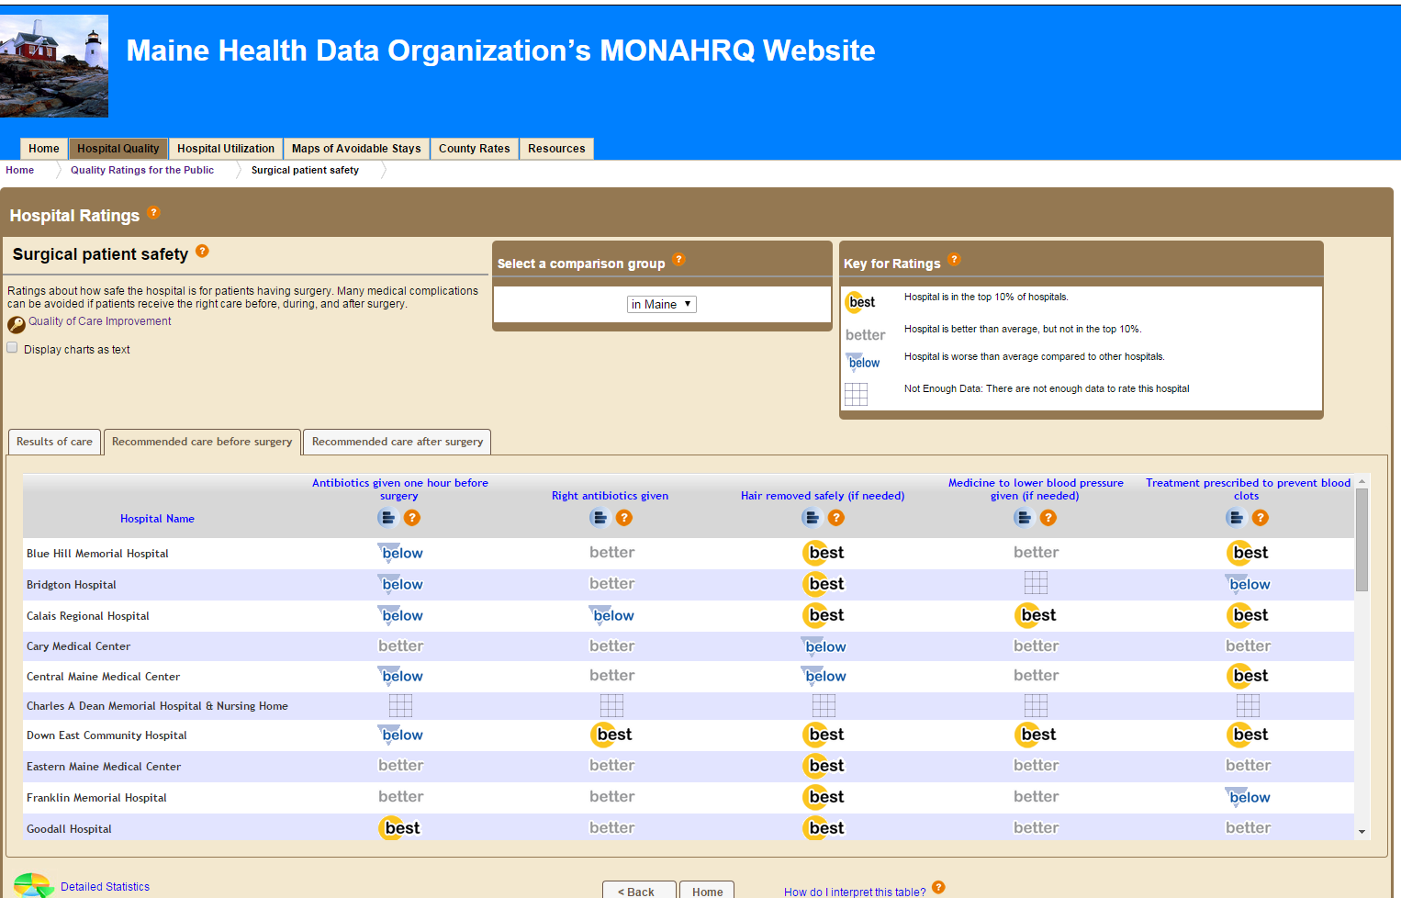
MONAHRQ 2.0.4

Slide 8
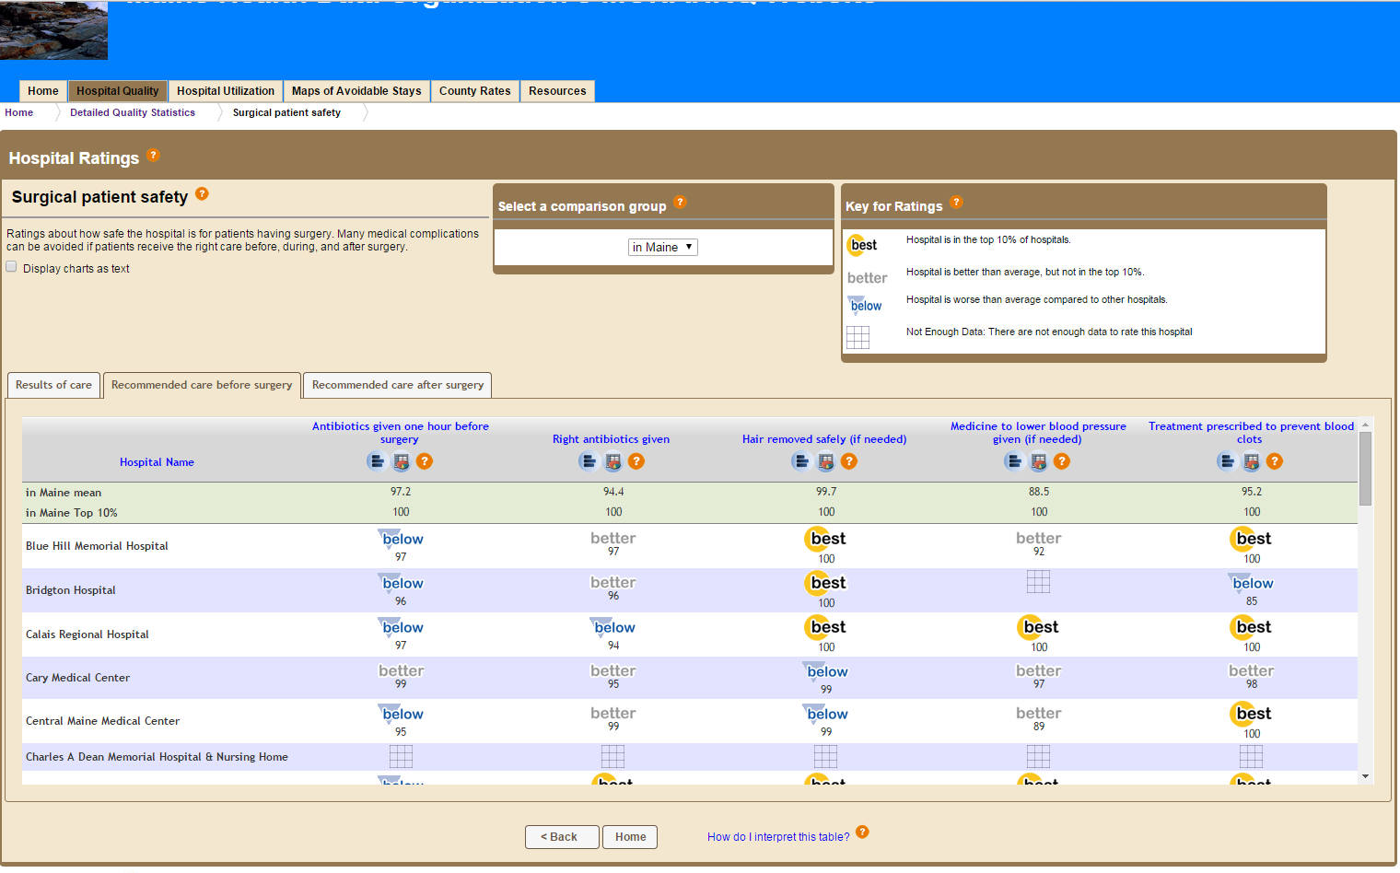
MONAHRQ 2.0.4

Slide 9
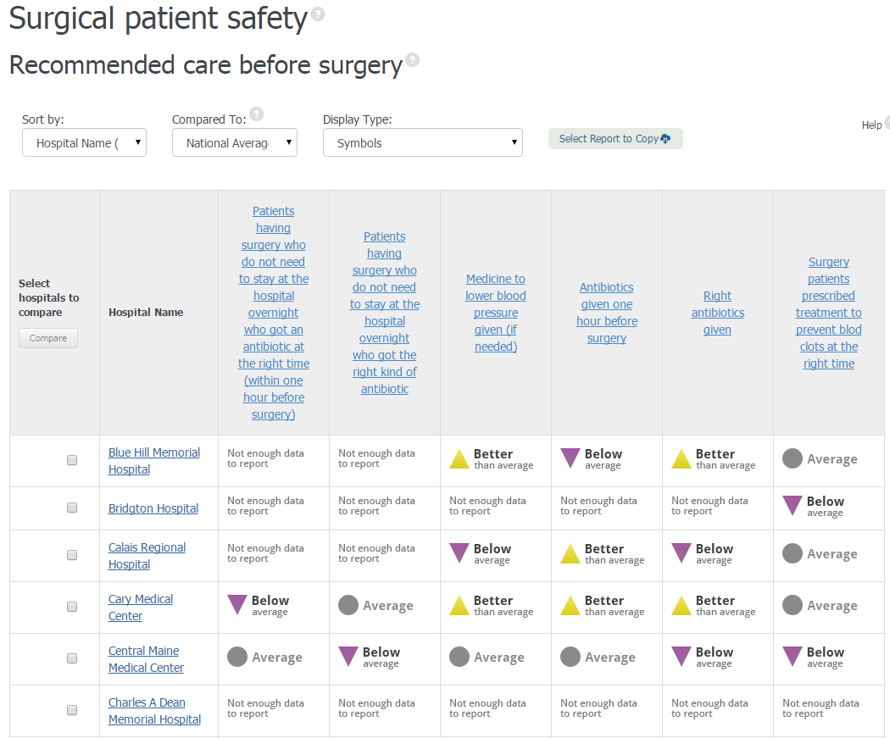
MONAHRQ 5.2

Slide 10

Future

Slide 11
Key Features of CompareMaine:
Enhancing the Methodology for Producing Cost Estimates
We have developed a methodology that is tailored to each procedure category.
Increasing the Number of Procedures
We are reviewing costs associated with approximately 300 shoppable health care services—that is, procedures that are high volume, non-urgent services that consumers plan for and schedule in advance.

Slide 12
Key Features Continued…
Expanding the Number of Facilities with Cost Information
We are reviewing the feasibility of reporting on approximately 300 different facilities, centers, provider practices.
Proposed Strategy to Add Quality Data
Consistent with our briefing to the MHDO board in March, we propose to display facility-level quality information alongside cost information. For the September release, we have focused on three quality measures:
Patient Experience (includes both hospitals and provider practices)
Serious Complications
Healthcare-associated Infections

Slide 13
Section 2:
Why are we integrating Healthcare Costs and Quality Data?
Title 22 Chapter 1683 §8712
CMS Grant Deliverables
Importance of both Healthcare Cost and Quality

Slide 14
Title 22 Chapter 1683 Maine Health Data Organization -§8712
1. Quality. The organization shall promote public transparency of the quality and cost of health care in the State in conjunction with the Maine Quality Forum established in Title 24-A, section 6951 and shall:
Collect, synthesize and publish information and reports on an annual basis that are easily understandable by the average consumer and in a format that allows the user to compare the information listed in this section to the extent practicable.
The organization's publicly accessible websites and reports must, to the extent practicable, coordinate, link and compare information regarding health care services, their outcomes, the effectiveness of those services, the quality of those services by health care facility and by individual practitioner and the location of those services.
The organization's health care costs website must provide a link in a publicly accessible format to provider-specific information regarding quality of services required to be reported to the Maine Quality Forum.

Slide 15
Title 24-A Chapter 87 MQF --§6951
10. Health care provider-specific data. The forum shall submit to the Legislature, by January 30th each year beginning in 2009, a health care provider-specific performance report. The report must be based on health care quality data, including health care-associated infection quality data, that is submitted by providers to the Maine Health Data Organization pursuant to Title 22, section 8708-A.

Slide 16
CMS Grant Deliverables Related to Incorporating Quality Data in New Website
  CMS Cycle III Grant (2013-15)
  Incorporate quality data from MONAHRQ with cost data
  Link and integrate other information on health care quality to cost information

Slide 17
Importance of Healthcare Cost and Quality
While the need to use cost and quality measures together to assess health system efficiency is well established, there is currently no clear consensus among stakeholders or recognized state of the art on how to do so. (National Quality Forum, “Efficiency and Value in Healthcare: Linking Cost and Quality Measures”, 2014)
Cost and quality of health care providers empowers consumers to make informed decisions. (Government Accountability Office “Health Care Transparency: Actions Needed to Improve the Cost and Quality of Information for Consumers”, 2014)
Consumers will use comparative performance data on providers if presented clearly (Hibbard "An Experiment Shows That A Well-Designed Report On Costs And Quality Can Help Consumers Choose High-Value Health Care“, 2012)
Both cost and quality are important for value: health care reform has shifted emphasis from containing costs to improving quality. (Porter, "What Is Value in Health Care?", 2010)
Improving the quality of care is a critical strategy for lowering costs (McClellan “Improving Health Care Quality: The Path Forward” Testimony to the U.S. Senate Committee on Finance, 2013)
Notes:
The citations are:
Ryan, A; Tompkins, C. (November 14, 2014) Efficiency and Value in Healthcare: Linking Cost and Quality Measures [Commissioned Paper by National Quality Forum] Retrieved June 1, 2015, from https://www.qualityforum.org/WorkArea/linkit.aspx?LinkIdentifier=id&ItemID=78231
Hibbard, J; Greene, J., Soafer, S.; Firminger K., and Hirsch, J. (2012). An Experiment Shows That A Well-Designed Report On Costs And Quality Can Help Consumers Choose High-Value Health Care. Health Affairs; 31:560-568.
McClellan, M. (2013). Improving Health Care Quality: The Path Forward. Testimony to the U.S. Senate Committee on Finance.
http://www.brookings.edu/research/testimony/2013/06/26-improving-health-care-quality-mcclellan
Porter, M. (2010). What Is Value in Health Care? New England Journal of Medicine; 363:2477-248.
http://www.nejm.org/doi/full/10.1056/NEJMp1011024
United States Government Accountability Office (2014). Health Care Transparency: Actions Needed to Improve the Cost and Quality of Information for Consumers. Report number GAO-15-11. http://www.gao.gov/products/GAO-15-11

Slide 18
Section 3: CompareMaine Plan for September Release
Quality Data Measures
Quality Data Display
Medical Episode Grouping
Review of Timeline and Next Steps

Slide 19
Important Note: Language on CompareMaine
Presenting healthcare quality and cost information is complex and technical in nature. As part of our website development, we are carefully writing and will vet the explanatory language that will be included on CompareMaine.

Slide 20
Quality Data Measures
Options and Recommendations for September 2015 Release

Slide 21
Process for Quality Measure Selection
Guiding Principle:
Data/information that is publically available
Overview of Process:
Review of National Landscape
Feedback from our Consumer Advisory Group

Slide 22
Quality Measure Recommendations for September Release of CompareMaine
Patient Experience (N=245 facilities/provider practices)
Utilize the relevant CAHPS measures for different provider types: HCAHPS for hospitals and CGCAHPS or PCMH-CAHPS for facilities/practices where those surveys are administered. The HCAHPS is a composite (developed by CMS) of different domains of patient experience. We use the single item construct of overall rating of the provider from PCMH and CG-CAHPS.
Serious Complications (N=19 facilities)
This measure is a composite (developed by CMS) that draws on 8 AHRQ Patient Safety Indicators and reflects facility level patient safety. The overall score for serious complications is based on how often adult patients had certain serious, but potentially preventable, complications related to medical or surgical inpatient hospital care.
Healthcare-associated Infections (N=35 facilities)
Utilize the hospital data that is submitted to the National Healthcare Safety Network per Chapter 270 which is used to calculate the C. difficile LabID events in the annual HAI Report.

Slide 23
Patient Experience Measure
Hospitals: H-CAHPS Summary Star: composite score from a survey of patient experiences from hospital stays (~34 hospitals).
  We use the composite measure that reflects domains including: communication with providers and staff, pain management, care transition and discharge information, cleanliness and quietness of the hospital and overall ratings
  Survey is administered to a random sample of adult inpatients between 48 hours and six weeks after discharge.
  Released for the first time in April 2015
  Source: CMS, to be updated annually

Slide 24
Patient Experience Measure (cont.)
Physician Practices: Patient Experience Matters PCMH-CAHPS (~249); Patient Experience Matters CG-CAHPS (~17).
  Responses from the single question of the patient’s overall rating of the provider on a scale of 0 to 10,(0=worst and 10=best).
  NCQA has a Patient-Centered Medical Home Recognition program; participation in PCMH CAHPS surveys can help provider groups earn points toward a higher recognition level
  Facilities participate voluntarily, often through a vendor; surveys are usually mailed to patients
  Source: Developed by AHRQ; sponsored by the Maine Quality Forum

Slide 25
Serious Complications Measure
The Agency for Healthcare Research & Quality (AHRQ) Patient Safety Indicators (PSIs) provides an overall score for serious complications based on how often adult patients had certain serious, but potentially preventable, complications related to medical or surgical inpatient hospital care. This risk-adjusted composite is based on the following eight measures:
collapsed lung that results from medical treatment (iatrogenic pneumothorax, PSI #06)
blood clots, in the lung or a large vein, after surgery (e.g. deep vein thrombosis, PSI #12)
a wound that splits open after surgery (postoperative wound dehiscence, PSI #14)
accidental cuts and tears (accidental puncture or laceration, PSI #15)
pressure sores (pressure ulcers, PSI #03)
infections from a large venous catheters (central venous catheter-related blood stream infection rate, PSI #07)
broken hip from a fall after surgery (postoperative hip fracture rate, PSI #08 )
blood stream infection after surgery (postoperative sepsis, PSI #13 )
All of these measures are reported individually on MONAHRQ.

Slide 26
Healthcare Associated Infections (HAI)
Maine hospitals are required to report data to MHDO on either how often HAIs occur or how well they follow recognized best practices designed to prevent:
Surgical site infections;
Central line catheter-associated blood stream infections;
Ventilator associated pneumonia infections and other complications;
Cases of MRSA (Methicillin-resistant Staphylococcus aureus); and
Cases of C. difficile (Clostridium difficile)
The MQF is required to report annually in collaboration with the Maine CDC on the status of Healthcare associated infections in the state of Maine.
2015 Annual HAI report includes new measures to report the presence of MRSA and C. difficile in Maine hospitals-LabID event

Slide 27
HAI Measures Considered
MRSA and C. difficile LabID Events
Instead of reporting the number of clinically diagnosed cases of MRSA or C. difficile infection, LabID event reporting counts the number of cases when the pathology lab identified the presence of MRSA or C. difficile in a patient sample.
The CDC recognizes LabID event rates (the ratio of LabID events to inpatient days) as a reasonably reliable proxy for infection rates.
Some patients can carry MRSA or C. difficile bacteria without developing a disease infection. Therefore, the LabID event rate will almost always appear higher than the actual infection rate.

Slide 28
HAI Recommended Measure: C. difficile
Between 1997 and 2004, the national death rate for C. difficile infections rose nearly five-fold from 1.5% to 6.9%. (Ghose, 2013)
Measure: Number of hospital-onset (HO) C. difficile LabID events per 10,000 patient days.
HO: LabID Event specimen collected more than 3 days after admission to the hospital (i.e., on or after day 4)
Notes:
source: Ghose, Chandrabali, Clostridium difficile infection in the twenty-first century, Emerging Microbes and Infections, vol. 2, p. 9, Sept. 2013. Accessed online on February 4, 2014 at: http://www.ncbi.nlm.nih.gov/pmc/articles/PMC3820989/

Slide 29
Quality Data Display
Presenting Quality Data
Using a 5 Point Scale
Using Word Icons
Options and Recommendations

Slide 30
Presenting Quality Data: Using a Five Point Scale
It is recommended that all three quality measures be rated on a five point scale. This recommendation:
Provides enough range to show variation in performance.
Fits within the cognitive limits for consumer choice.
Aligns with the five star quality rating initiative now being implemented across all of the CMS quality websites (Dialysis Facility Compare, Home Health Compare, Hospital Compare, Nursing Home Compare, and Physician Compare) as well as Medicare Plan Finder and the Health Insurance Marketplace.

Slide 31
Presenting Quality Data: Using a Five Point Scale
Recommendation:
Use a five point scale that looks at the top performing facilities (top 10%), lowest performing facilities (bottom 10%) with an even distribution among the middle three performing facilities (11 to 33%, 34 to 66% and 67 to 90%).
  Selection of the top and lowest performing facilities is a similar approach to the Get Better Maine approach and the CMS approach used for some its websites and modified for a five point scale.
  Future option may be to compare Maine facilities to national benchmarks as each measure becomes available.

Slide 32
Displaying on a Five Point Scale: Word Icons
Word icons have long been the preferred way to display health care quality ratings display for a variety of reasons including:
  Symbols, colors, and words work together to help consumers identify patterns
  Consumers prefer visual data that are easy to interpret
  They quickly communicate meaningful information to consumers
  (Hibbard and Sofaer 2010).
Recommendation:
Use an icon and words to display the facility level results. Use word icons that use shapes, color, and labels to distinguish higher from lower quality.
Use the same icon and words for all three quality measures.

Slide 33
Ratings used on
CMS Compare sites
Ratings used on GetBetterMaine
Ratings used on MONAHRQ 5.2
Best
Better
than average
Better
Average
Good
Low
Below average

Slide 34
5 Point Word Choices
There are a variety of labels and descriptors used across leading websites. Descriptors include:
Best, Better, Average, Below and Low
Top, Above, Average, Below, Poor
Excellent, Very Good, Good, Fair, Poor
Much Above Average, Above Average, Average, Below Average, Much Below Average (recommendation)

Slide 35
Recommendation for CompareMaine
Much Above Average
Above Average
Average
Below Average
Much Below Average

Slide 36
Alternative Options
Use a different symbol with words
Use only a symbol, no words

Slide 37
 | Overall Patient Experience Rating | Serious Complications | Healthcare-Associated Infections
Facility Name 123 Avenue Street City, State 12345
Facility Name 123 Avenue Street City, State 12345
Facility Name 123 Avenue Street City, State 12345
Much Above Average
Average
Average
Much Above Average
Above
Average
Below Average
Above
Average
Average
Much Below
Average

Slide 38
 | Overall Patient Experience Rating | Serious Complications | Healthcare-Associated Infections
Facility Name 123 Avenue Street City, State 12345
Facility Name 123 Avenue Street City, State 12345
Facility Name 123 Avenue Street City, State 12345
Much Above Average
Average
Average
Much Above Average
Much Above Average
Much Above Average
Much Below Average
Much Below Average
Average

Slide 39
Next Steps
  June Meeting:
  Board approval to test recommended data displays with our Consumer Advisory Group and through cognitive testing with a sample of representative users. Cognitive testing is testing whether users understand the language on the site and if they can find and use the information they need.
  Early July:
  Distribute results of how each Maine facilities scores on the five point scale for each of the three quality measures.
  July Retreat:
  Board approval of the quality data to include in CompareMaine

Slide 40
Medical Episode Grouping
Recommendation on Medical Episode Grouping Software for Specific Inpatient and Outpatient Procedures

Slide 41
Increasing the Number of Procedures
CompareMaine will contain the costs associated with approximately 300 shoppable health care services
—that is, procedures that are high volume, non-urgent and services that consumers would plan for and schedule in advance. The following are the procedure categories under review:
Office Visits
Mental and Behavioral Health Services (21)
Physical and Occupational Therapy (20)
Wound Management (5)
Nutrition Services (3)
Acupuncture (4)
Osteopathic Manipulative Treatment (5)
Office or Outpatient Visit (10)
Specialist Consultation (5)
Emergency Department Visit (5)
Pediatric or Adolescent Preventative Care Office Visit (or Wellness Office Visit) (8)
Adult Preventative Care Office Visit (or Wellness Office Visit) (6)
Laboratory Services
Blood Test (77)
Fecal Test (3)
Swab Test (8)
Radiology and Imaging
CT (Computed Tomography) Scans (12)
MRI (Magnetic Resonance Imaging) Scans (8)
X-Rays (10)
Ultrasounds (6)
Mammograms (5)
Other Imagining Procedures (6)
Inpatient/Outpatient Procedures
Joint Surgery (9)
Diagnostic and Biopsy Procedures (17)
Obstetric/Gynecological Procedures (8)
Cardiac and Circulatory System Procedures (7)
Urinary System Procedures (5)
Respiratory System Procedures (5)
Common Surgeries and Procedures (10)
Male Reproductive System Procedures (2)
Ear and Eye Procedures (6)

Slide 42
Enhancing Methodology for
Producing Cost Estimates
Approach: We have developed a nuanced methodology tailored to each procedure category.
For the Inpatient/Outpatient Procedure category, we have been working with a “Grouper” to produce a cost estimate.

Slide 43
Episode “Groupers”
  Episode grouping involves linking claims records together based on their association with an illness, some of which can transcend patient care settings and even different payers.
  An episode as defined by the National Quality Forum (NQF) Episodes of Care Framework is a series of temporally adjoining healthcare services related to the treatment of a given illness or provided in response to a specific request by the patient.
  Grouping software packages vary by ways in which they determine which claims should be included in the episode (e.g., time frame, exclusivity to other episodes) and in their methods of patient risk-adjustment.

Slide 44
Episode “Groupers”
  We examined three Grouper options:
    Truven “MEG”: Capable of linking inpatient and outpatient claims across facility types for 590 episodes of care; adjustable parameters for producing episodes
    3M Core Grouper: Tool to risk-adjust DRGs rather than group episodes; unable to link claims across facility types and no clinical logic available to do so manually
    PROMETHEUS: Offers free episode definitions (CPT, ICD-9 codes for episodes) for 80 procedures; clinical logic would still need to be developed & applied

Slide 45
Grouper Recommendation
    Recommendation:
    Use Truven “MEG” for broad functionality, in-house knowledge and use in published literature
      NORC has successfully produced episode costs of care for 59 care bundles using the MEG on Maine’s data. (Refer to detailed procedure list)
      Truven updates the MEG tool’s coding logic on a regular basis.

Slide 46
Next Steps
June Meeting
  Board approval to move forward with grouper recommendation.

Slide 47
Timeline for September Launch
Task | Deadline
Finalize website design and begin Quality Assurance and Cognitive testing | 6/17/2015
Hold Webinar for Health Plans and Providers to Kick-off Data Review for Procedures Costs AND…… (45 Days for review) | 6/19/2015
Draft all CompareMaine language | 6/30/2015
Consumer Advisory Group Meeting | 7/10/2015
External review of draft CompareMaine language for accessibility and understandability | 7/12/2015
Test website functionality | 7/15/2015
Present development website to Board | 7/16/2015
Cognitive testing | 7/24/2015
Utilize feedback to refine the development website and content | 8/5/2015
Final review and Quality Assurance of CompareMaine | 8/20/2015
Webinar for Key Stakeholders announcing CompareMaine | 9/29/2015
Public launch of CompareMaine | 9/30/2015

Slide 48
Team
Karynlee Harrington, MHDO
Acting Executive Director
Kimberly Wing, MHDO
Programmer Analyst
David Hughes, HSRI
Project Director
Leanne Candura, HSRI
Project Manager
Margaret Mulcahy, HSRI
Research Analyst
Kevin Rogers, HSRI
Product Development Lead
Kate Mullins, HSRI
Assistant Project Manager
Tim Mulcahy, NORC
Deputy Project Director
Elaine Swift, NORC
Principal Research Scientist
Aaron Wesolowski, NORC
Senior Research Scientist
Kathy Rowen, NORC
Research Scientist
Scot Ausborn, NORC
Data Scientist
Judith Hibbard, University of Oregon
Senior Researcher
Mellissa Hillmyer, Wowza
Account Strategist

