Slide 1

MHDO Board Meeting
March 5, 2015

Slide 2
Introduction of Team
Karynlee Harrington, MHDO
Acting Executive Director
Kimberly Wing, MHDO
Programmer Analyst
David Hughes, HSRI
Project Director
Leanne Candura, HSRI
Project Manager
Margaret Mulcahy, HSRI
Research Analyst
Kevin Rogers, HSRI
Product Development Lead
Kate Mullins, HSRI
Assistant Project Manager
Tim Mulcahy, NORC
Deputy Project Director
Elaine Swift, NORC
Principal Research Scientist
Aaron Wesolowski, NORC
Senior Research Scientist
Kathy Rowen, NORC
Research Scientist
Scot Ausborn, NORC
Data Scientist
Judith Hibbard, University of Oregon
Senior Researcher
Mellissa Hillmyer, Wowza
Account Strategist

Slide 3
Table of Contents
Review of Title 22 Chapter 1683 section 8712 – Slide 4
  Current Fulfillment
  National Landscape
Review Key Feedback from MHDO Consumer Subcommittee – Slide 11
Review Grant Deliverables – Slide 15
  Health Cost and Quality Website Activities
  Health Data Transparency and Dissemination Activities
Review of Consumer Advisory Group – Slide 20
  Composition
  Roadmap
  Recommendations
Review Current State and Future of HealthCost – Slide 25
  Review of Current State
  Review of Limitations
  Improved Methodology
  Key Enhancements
Incorporating Quality Data – Slide 38
  National Landscape
  Quality Efforts in Maine
  Consumer Advisory Group Input
  Measure Recommendations
Review of MONAHRQ 5.0 – Slide 48
Pulling It All Together – Slide 55
  Review of Wireframes
  Timeline
Recommendations, Board Discussion & Next Steps – Slide 58
Public Comment – Slide 60

Slide 4
Title 22 Chapter 1683 §8712
Requirements under the Law
National Landscape

Slide 5
Title 22 Chapter 1683 §8712
REPORTS
The organization shall produce clearly labeled and
easy-to-understand reports as follows. Unless otherwise specified, the organization shall distribute the reports on a publicly accessible site on the Internet or via mail or e-mail, through the creation of a list of interested parties. The organization shall make reports available to members of the public upon request.

Slide 6
Title 22 Chapter 1683 §8712
1. Quality. The organization shall promote public transparency of the quality and cost of health care in the State in conjunction with the Maine Quality Forum established in Title 24-A, section 6951 and shall:
Collect, synthesize and publish information and reports on an annual basis that are easily understandable by the average consumer and in a format that allows the user to compare the information listed in this section to the extent practicable.
The organization's publicly accessible websites and reports must, to the extent practicable, coordinate, link and compare information regarding health care services, their outcomes, the effectiveness of those services, the quality of those services by health care facility and by individual practitioner and the location of those services.
The organization's health care costs website must provide a link in a publicly accessible format to provider-specific information regarding quality of services required to be reported to the Maine Quality Forum.

Slide 7
Title 22 Chapter 1683 §8712
2. Payments. The organization shall create a publicly accessible interactive website that:
Presents reports related to payments for services rendered by health care facilities and practitioners to residents of the State.
The services presented must include, but not be limited to, imaging, preventative health, radiology and surgical services and other services that are predominantly elective and may be provided to a large number of patients who do not have health insurance or are underinsured.
The website must also be constructed to display prices paid by individual commercial health insurance companies, 3rd-party administrators and, unless prohibited by federal law, governmental payors. Beginning October 1, 2012, price information posted on the website must be posted semiannually, must display the date of posting and, when posted, must be current to within 12 months of the date of submission of the information.

Slide 8
Title 22 Chapter 1683 §8712
3. Comparison report.
4. Physician services.
At a minimum, the organization shall develop and produce an annual report that compares the 15 most common diagnosis-related groups and the 15 most common outpatient procedures for all hospitals in the State and the 15 most common procedures for nonhospital health care facilities in the State to similar data for medical care rendered in other states, when such data are available.
The organization shall provide an annual report of the 10 services and procedures most often provided by osteopathic and allopathic physicians in the private office setting in this State. The organization shall distribute this report to all physician practices in the State. The first report must be produced by July 1, 2004.

Slide 9

Public Reporting: MHDO and MQF
Current
  HealthCost
Future
  MONAHRQ
  Patient Experience Matters
  Annual Healthcare Associated Infections Report
  MQF Hospital Utilization/Variation Reporting

Slide 10
National Landscape
  Environmental scan of other cost websites in this space:
  19 state sites, including an in depth review of 5 (CO, FL, MA, MN, NH)
  5 non-state sites
    OpsCost www.opscost.com
    New Choice Health www.newchoicehealth.com
    Healthcare Bluebook www.healthcarebluebook.com
    Castlight www.castlighthealth.com
    FH Consumer Cost Lookup www.fairhealthconsumer.org
    Briefly reviewed other transparency websites:
    Change Healthcare www.changehealthcare.com
    ConsumerReports www.consumerreports.org
    CalQualityCare www.calqualitycare.org
    Get the Deal on Care www.getthedealoncare.org

Slide 11
Key Feedback from MHDO Consumer Subcommittee
Recommendations of the Board Subcommittee assisted in shaping the deliverables in the grant applications

Slide 12
Recommendations from MHDO Consumer Subcommittee
  Expand master list of the initial 29 procedures to the grant funded 200—and as many as possible thereafter with all payer and provider claims data.
  Include the Choosing Wisely® in Maine focus area procedures:
    Imaging (EKGs, stress tests, cardiac catheterization)
    Imaging tests (CT scan, MRI) for low back pain
    Imaging tests (CT scan, MRI) for uncomplicated headaches
    Bone-density (DEXA) scans for low-risk women
  Link and integrate information on health care quality and cost including MONAHRQ, Chapter 270 quality data and GetBetterMe.
  Provide linkages to discount or low-cost drug resources and explore feasibility of providing public access to comparative drug cost information.
  Explore the inclusion of Medicare and Medicaid data into the MHDO HealthCost website and identify options for such expansion.
  Explore and consider potential website improvement funding sources (i.e., grants)

Slide 13
Recommendations from MHDO Consumer Subcommittee
  Provide user-friendly explanations and definitions of health cost and consumer-related terms on HealthCost website.
  Offer a HealthCost site user feedback function (i.e., survey) to support relevant and meaningful public engagement with health cost information and to assess consumer education needs in regard to cost and quality information.
  Reevaluate, modify, and improve methodologies for determining average payments of procedures for the insured population.
  Reevaluate methodologies for presentation of pricing for uninsured.

Slide 14
Recommendations from MHDO Consumer Subcommittee
  Designate and expand website information clearing house role including:
    Linkage with carrier cost calculator tools and cost information resources
    Explore and provide alternative resources for insured population if and when access to cost calculator information is not provided by their carrier(s).
    Collaborate on and support LD 990 including requirement to educate consumers about MHDO HealthCost website cost assessments and information.
  Expand public awareness campaign in alignment with “Transparency in Health Care Pricing, Cycle III” grant–identified processes and programs.
  Evaluate potential awareness campaign linked to public data release (i.e., recent CMS Inpatient and Outpatient hospital charge data releases) including the possibility of broader public data access through free release of limited data sets, or public access to standard queries of APCD. This evaluation should consider the context of ongoing transformation activities.
  Collaborating with and link to other state and regional health data and analysis efforts (i.e., HP 1123, SIMS)

Slide 15
CMS Grant Deliverables
  CMS Grants to Support States in Health Insurance Rate Review and Increase Transparency in Health Care Pricing - Cycle III & Cycle IV

Slide 16
  Review of Grant Deliverables:
  Key Objectives from CMS Cycle III Grant (2013-15)
  Health Cost and Quality Website Activities
  Increase the number of “shoppable” procedures
  Incorporate quality data from MONAHRQ with cost data
  Link and integrate other information on health care quality to cost information
  Evaluate the inclusion of Medicare and Medicaid data on the cost website
  Reevaluate, modify, and improve methodologies for determining average payments of procedures for the insured population and explore presenting pricing for uninsured
  Evaluate links and integration with other efforts in Maine involving health data (e.g., CMS SIM grant) and commercial plans’ cost calculators and price information
  Evaluating linking to or incorporating prescription drug pricing information
  Incorporate more powerful tools for online analysis (e.g., allow users to select specific CPT codes, hospitals, and/or geographical areas)
  Improve accessibility for mobile devices so that MHDO and other health organizations can more easily develop apps that leverage MHDO data
  Improve user interface and usability of site
  Provide appropriate tools and data as separate paths on the site for researchers, employers, providers, consumers and other stakeholders
  Improve web IT infrastructure to make site more modular and flexible, supporting ease of change in the future (i.e., move to content management system)
  Make use of APIs to access data dynamically from a variety of analytic tools

Slide 17
Review of Grant Deliverables:
Key Objectives from CMS Cycle III Grant (2013-15)
  Health Data Transparency and Dissemination Activities
  Evaluate and potentially build infrastructure to support national claims and hospital encounter data sets (i.e., ASC-X12 837 PACDR and ASC-X12 837)
  Improve communication and outreach to the public to raise awareness of MHDO as a resource for health cost and quality data
    Awareness campaign
    Develop a mechanism for website user feedback
  Collaborate with other state and regional health data and analysis efforts
  Work collaboratively with stakeholders to better respond to their needs for data and transparency

Slide 18
  Review of Grant Deliverables:
  Key Objectives from CMS Cycle IV Grant (2014-16)
  Health Cost and Quality Website Activities
  Increase the number procedures displayed
    Add additional medical procedures
    Develop and implement an inpatient procedure category and affiliated procedures
    Add mental health/substance abuse procedure category and affiliated procedures
    Explore adding a dental procedure category and affiliated procedures
    Explore adding and enhancing pricing information for pharmacy data (previous activities focused on researching and linking to external data sources)
  Increase the number of non-hospital facilities displayed
  Define clinical data to collect (such as laboratory results) and explore integration options
  Enhance the consumer website experience on computers, tablets, and mobile devices
  Enhance the procedure search function (possibilities include searching for facilities by a clickable county map and searching for procedures by clicking on relevant areas of the human body)
  Enhance data display (possibilities include displaying color-coded price variation on a county map; reporting cost using symbols or words rather than numbers)

Slide 19
Review of Grant Deliverables:
Key Objectives from CMS Cycle IV Grant (2014-16)
  Health Data Transparency and Dissemination Activities
  Work with stakeholders to develop an online data request system to collect information required for data release and streamline the release process
  Research and make recommendations on the best data payment model options that promote access and sustainability
  Research and make recommendations on options for self-service access to data
  Support the ongoing activities of the Consumer Advisory Group

Slide 20
Review of Consumer Advisory Group
  Composition of Consumer Advisory Group
  Roadmap
  Recommendations

Slide 21
Consumer Advisory Group Composition
Group Charge: The MHDO Consumer Advisory Group will provide input and guidance to the Agency on its efforts to provide and integrate comprehensive and useful health care cost and quality data through its publicly accessible venue for Maine people.
Governance Structure: The MHDO Consumer Advisory Group serves in an advisory role, and provides recommendation to the MHDO staff and, when appropriate, the MHDO Board. Decisions within the Group will be made by consensus.
Membership: The Quality Counts Consumer Advisory Council plus additional members.

Slide 22
Consumer Advisory Group-Overview of Roadmap
May 16, 2014
Overview of Road Map and Review of MHDO’s Current Website
July 11, 2014
External Resources, Including Prescription Drug Pricing Information
Sept. 12, 2014
Persona Presentation; Quality Indicators Part I, Including Integrating MONAHRQ Data
Nov. 14, 2014
Quality Indicators Part II
Jan. 9, 2015
Review of MONAHRQ, plan to integrate cost and quality, HealthCompare style tiles
March 13, 2015
Review draft of revised website
May 8, 2015
Awareness Campaign
July 10, 2015
Review MHDO’s CMS Grant Product Plan (website, consumer guides etc.) and Timeline
Sept. 11, 2015 (tentative)
Celebrate Achievements and Discuss Next Steps

Slide 23
Consumer Advisory Group Recommendations:
Website Function
  Focus on ease of access
  Ensure the website is accessible
  Allow searching by code or by procedure using patient-centered terminology
  Add a way to search visually by part of the body
  Provide a way to see costs by insurance and by provider
  Add color
  Make sure the site is touchscreen-friendly
  Provide Technical Assistance for the site; dedicated email or hotline
  Provide an application on HealthCost to translate the site into other languages

Slide 24
Consumer Advisory Group Recommendations:
Website Content
  Define the purpose and vision for the HealthCost site.
  Make HealthCost a one-stop-shop. Have information on procedures, hospitals, and physicians in one place.
  Provide different types of information for patients and others. We are most interested in patients—defined as empowered, informed consumers.
  Remove the provider-centric categories in the Cost Compare steps.
  Make sure that behavioral/
  mental health services are among the choices.
  Add links to information about transportation options.
  Make sure costs are provided for every type of consumer regardless of their coverage.
  Include information about various Medicaid/Medicare formularies.
  Provide more information on prescription medications such as the cost and efficacy, providers’ costs, providers’ contracts, and reimbursement rates.
  Develop a mechanism for updating the resources annually.
  Make the Resource page more interactive, less of a list.

Slide 25
Current and Future State of HealthCost
  Review of Current State
  Review of Limitations
  Improved Methodology/consulted with external experts
  Key Enhancements

Slide 26
Maine HealthCost: Current State
Costs for 159 procedures in the following categories:
  Emergency Department
  Lab Tests
  Office Visits
  Outpatient Procedures
  Radiology and Diagnostic imaging
  Data from 56 facilities
  Does not display data by payer

Slide 27
Key Limitations and Enhancements
HealthCost 2014 Limitations | HealthCompare Maine End State Enhancements
Missing data | Methodological improvements to bring in more data
Limited number of facilities and exclusion of provider practices | Bringing in clinics, imaging centers, labs, and provider practices
One-size-fits-all cost methodology | Developing nuanced methodology tailored to each CPT code category
No quality data | Adding three categories of quality data (patient experience of care, Healthcare-associated infections, surgical complications)
Outdated interface and web design | Contracted with web design firm to reenvision the site

Slide 28
HealthCompare Maine:
More Data
Name of HealthCost Procedure | Procedures with 3 or fewer facilities with data | Facilities with Low N Suppression
Emergency Visits | 0 | 12.5%
Lab Test | 40 | 62.9%
Office Visit | 8 | 34.6%
Outpatient Procedure | 10 | 29.0%
Radiology & Diagnostic | 3 | 14.9%
  Improve procedure/facility matching to increase low Ns
  Better analyze imaging claims data
  Increase number of facilities with lab data
  Bring back the 24 procedures that were pulled because of quality concerns
  Bring in the 14 procedures that had low Ns for all facilities reporting on them
  Relax professional and facility claim requirements where appropriate

Slide 29
HealthCompare Maine:
More Facilities
Expanding the number of facilities
Facility Type | HealthCost 2012 | Current HealthCost | Under Review for HealthCompare Maine
Total | 75 | 56 | 130
Ambulatory Surgical Center | 12 | 10 | 15
Clinic | 3 | 2 | 49
Hospital | 36 | 35 | 39
Psychiatric Facility | 3 | 1 | 4
Imaging | 16 | 7 | 17
Unclassified | 5 | 1 | 6

Slide 30
HealthCompare Maine:
Inclusion of Provider Practices
Per Title 22 Chapter 1683 §8712, end state goal is to include provider practices
Targeting to include for September release
  Challenges Include:
    Identifying provider practices for inclusion
    Matching the identified providers with an NPI
    Ensuring providers have sufficient claim volume to protect PHI

Slide 31
HealthCompare Maine:
More Shoppable Procedures
Category | Healthcost 2012 | Current Healthcost | Proposed for HealthCompare Maine
Total | 30 | 159 | 310
Office Visit – Emergency Department, Mental/Behavioral Health, PT, OT, CAM | 0 | 21 | 111
Labs | 0 | 64 | 93
Radiology and Imaging | 19 | 30 | 47
Inpatient/Outpatient Procedures | 11 | 44 | 59

Slide 32
HealthCompare Maine:
More Shoppable Procedures
Additional procedures selected based on:
  Consumer Advisory Group Feedback (Mental Health, Cardiac, Maternity)
  Board Feedback (Inpatient)
  Volume (frequently occurring procedures)
  Shoppability (Physical Therapy and Chiropractic)
  Choosing Wisely Procedures (variety of imaging procedures)

Slide 33
HealthCompare Maine:
Improved Methodology
Reviewed CPT codes with billing expert to determine:
  Which (if any) CPT codes to bundle
  Whether to include professional claims, facility claims, or both
  If the code was current
  Which modifiers can be used with the code
  Alternative procedures
  Reviewed methodology with subject experts (hospital administrators, payors) to determine:
  Best method of cost averaging
  Data cleaning/outlier removal
  Cost attribution (billing provider or service provider; parent organization or affiliated group)
  Grouping of facilities on website

Slide 34
HealthCompare Maine:
Improved Methodology
Revising cost calculations:
  Better matching between facilities and claims
  More purposeful data cleaning
  Better identification of final, adjudicated claim
  Improve complexity calculations

Slide 35
HealthCompare Maine:
Improved Methodology – Episode “Groupers”
  Medical Episode Groupers—examine the costs for an episode across facilities, payers and providers.
  Help examine variability in total price of an episode of care, not just a procedure
  National-level interest in this approach: informs value-based purchasing
    Currently examining the Truven “MEG”
    Also discussing PROMETHEUS with HCI3: offers free episode definitions (CPT, ICD-9 codes for episodes) but clinical logic would still need to be developed & applied
    Will also explore 3M Core Grouper, although primarily a tool to risk-adjust DRGs rather than group episodes

Slide 36
HealthCompare Maine:
Quality Data
Detailed plan to integrate quality metrics into the cost display to allow consumers to make informed healthcare decisions

Slide 37
HealthCompare Maine:
Key Enhancements
Contracted with design firm WOWZA to create a new and interactive website that is easily accessible on mobile devices.

Slide 38
Incorporating Quality Data
  National Landscape
  Public reporting of health care Quality in Maine-MONAHRQ, Patient Experience Matters, GET BETTER MAINE
  Consumer Advisory Group Input
  Measure Recommendations

Slide 39
National Landscape
A number of national developments in transparency support the work of MHDO and make it unique:
  CMS support for state APCDs (ongoing)
  Support for development of cost transparency websites via CCIIO Rate Review grants
  Focus on HIT, data analysis and quality reporting in CMMI State Innovation Model (SIM) program (ME is round 1 test state awardee)
  Increasing transparency of Medicare data from CMS
  New data release process for inclusion of Medicare data
  Release of new CMS cost and quality data
  Hospital Star ratings (2015): Overall quality (by provider/facility) and domain-specific (e.g., CAHPS) ratings rolled out to all Compare websites.

Slide 40
National Landscape
Other cost and quality sites:
  There are numerous sites operated by states, companies and foundations
  They rarely present both cost and quality information for facilities or procedures – usually one or the other, or “cost” data is actually charge data with less utility to consumers
  Including both cost and quality information provides consumers with comprehensive tools needed to make more informed choices
  Maine’s mandate is for a site that offers both, which is unique
  Maine is already seen as a leader in cost and quality transparency

Slide 41
Consumer Advisory Group: Input
MHDO has engaged closely with the Consumer Advisory Group on selection and display of quality measures
  November 2014: Members reviewed six healthcare quality resources.
  Members identified process, outcome and patient satisfaction measures from a number of other sites.
    Process: Timely appointments and provider availability
    Outcome/Safety: Hospital acquired infections and safety
    Patient satisfaction: Overall rating and patient recommendations

Slide 42
Consumer Advisory Group: Input
In February, the group was asked to identify key elements they liked about consumer-friendly cost and service websites, such as:
  Favorite websites that present information on choosing consumer shopping sites, with information on product, cost, consumer rating/quality, etc.
  Characteristics of a typical visit, such as goal of the visit, how the site was found, and how long the session lasted
  What features were most/least liked about a typical visit to each site

Slide 43
Consumer Advisory Group: Synthesis
Members expressed interest in detailed quality information as well as simple and clear display. MHDO must balance these two elements.
  Attempting to address this by:
    Focusing on patient experience and infection rates for hospitals
    Identifying additional measures as appropriate and available for other provider types
    Providing meaningful context for all quality information displayed on the site
    Considering linking to other sites (e.g., MONAHRQ) for more detailed quality information
  Identification of appropriate measures is an iterative process; data will be added and display revised as the site develops, new data become available, and the efficacy of measures is demonstrated

Slide 44
Quality Measure Recommendation
Bring cost and quality together to help consumers find value
Category Recommendations:
  Patient experience of care (HCAHPS Summary Star Rating & other patient experience data at practice level where available)
  Healthcare-associated infections
  Surgical complications
Use facility-level hospital quality measures where valid
Assess availability and relevance of measures for non-hospital providers and facilities

Slide 45
Indicating Quality of Physician Groups and Non-Hospital Facilities
  Limited number of quality measures for clinical services for physician groups and non-hospital facilities
  Limited number of quality measures available for individual CPT codes
Recommendation: Display quality measures at the hospital level to indicate quality of physician groups and non-hospital facilities affiliated with hospitals

Slide 46
Using Hospital-Level Quality Measures to Indicate Quality of Hospital-Affiliated Providers/Facilities
Advantages
  Scientifically sound, dependably collected, and timely
  Meaningful to consumers as established by consumer research
  Leverages available data; there are extensive hospital data available via CMS, which is not consistently the case for other facility and provider types
  Allows a relatively consistent perspective on quality reporting for hospitals and affiliated facilities
Disadvantages
  Does not apply to providers and facilities not affiliated with hospitals, so data displayed for providers of similar or same services will not have consistent quality info; this is a limitation of the available data
  Most relevant to providers and facilities in a highly integrated hospital system
  Doesn’t provide procedure- or condition-specific quality info to correspond to procedure level cost information

Slide 47
Next Steps
Continue to refine quality measures displayed on website
  Example: CMS plans to make available global hospital quality ratings in 2016
  Physician quality measures at practice and individual provider levels are also planned
  Explore use of patient reported outcome measures (PROMIS)
Continue to pursue procedure- or condition-level quality measures
  Involves identifying specific, clinically appropriate measures that correspond to episodes of care used for calculating cost information
  Is likely feasible in the long term, but will involve additional study and alignment as there are currently no standards or best practices for selecting quality for specific procedures

Slide 48
MONAHRQ 5.0
Review of 5.0
Decision points regarding the financial information we display

Slide 49
Review of Current MONAHRQ 5.0 Test Site
Information on hospital quality, utilization, and avoidable stays
Data from:
  MHDO’s Inpatient Discharge Data
  Medicare Provider Charge Data
  CMS Hospital Compare
  AHRQ Quality Indicators (populated with MHDO Inpatient Data)
  Live demonstration of 5.0 Test Site

Slide 50
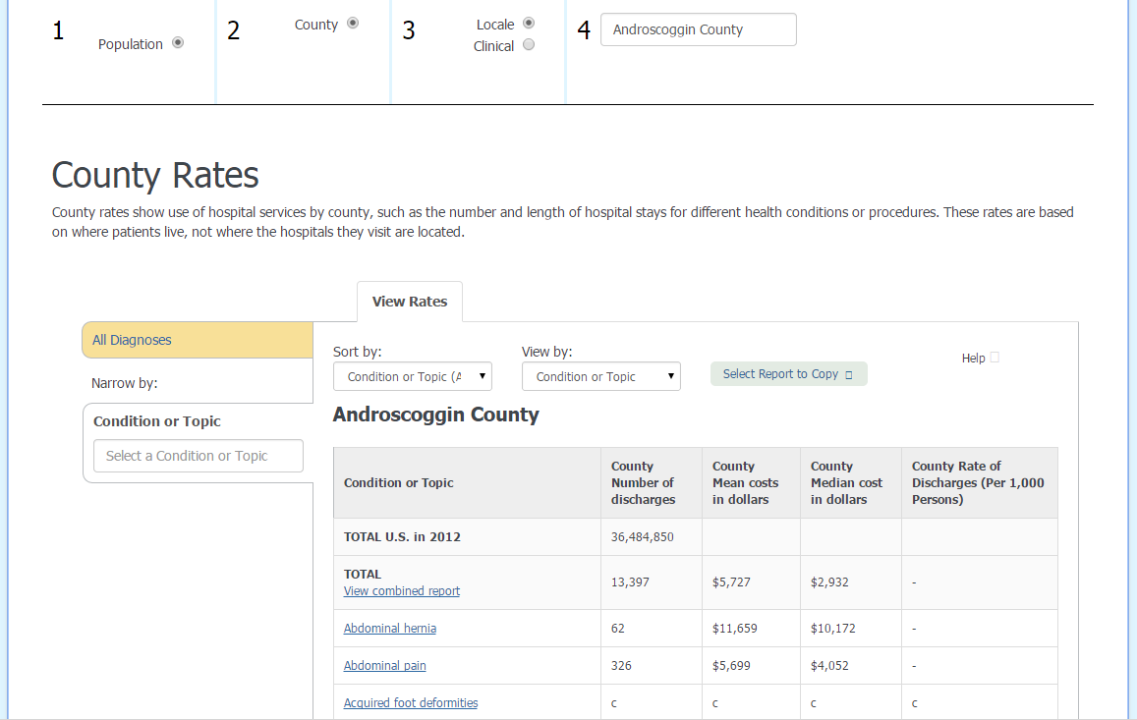
MONAHRQ 5.0-County Utilization
Currently display
  County number of discharges
  Mean cost in dollars
  Median cost in dollars
  County rate of discharges
  Could also display
  Mean charge in dollars
  Median charge in dollars

Slide 51
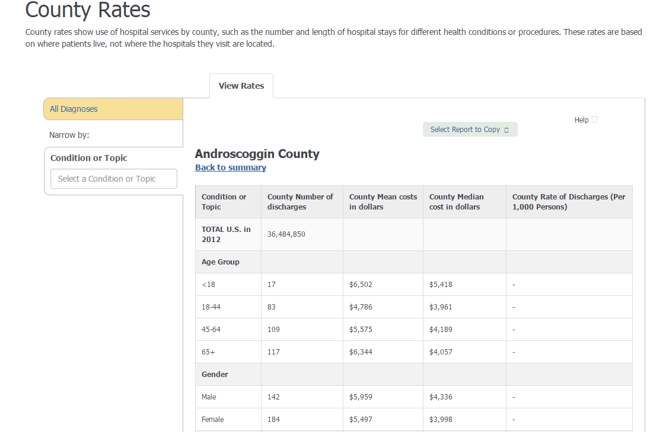
MONAHRQ 5.0-County Detailed Utilization
  Currently display:
  Discharge, financial, and LOS by:
  Age
  Gender
  Payer type
  Race/Ethnicity

Slide 52
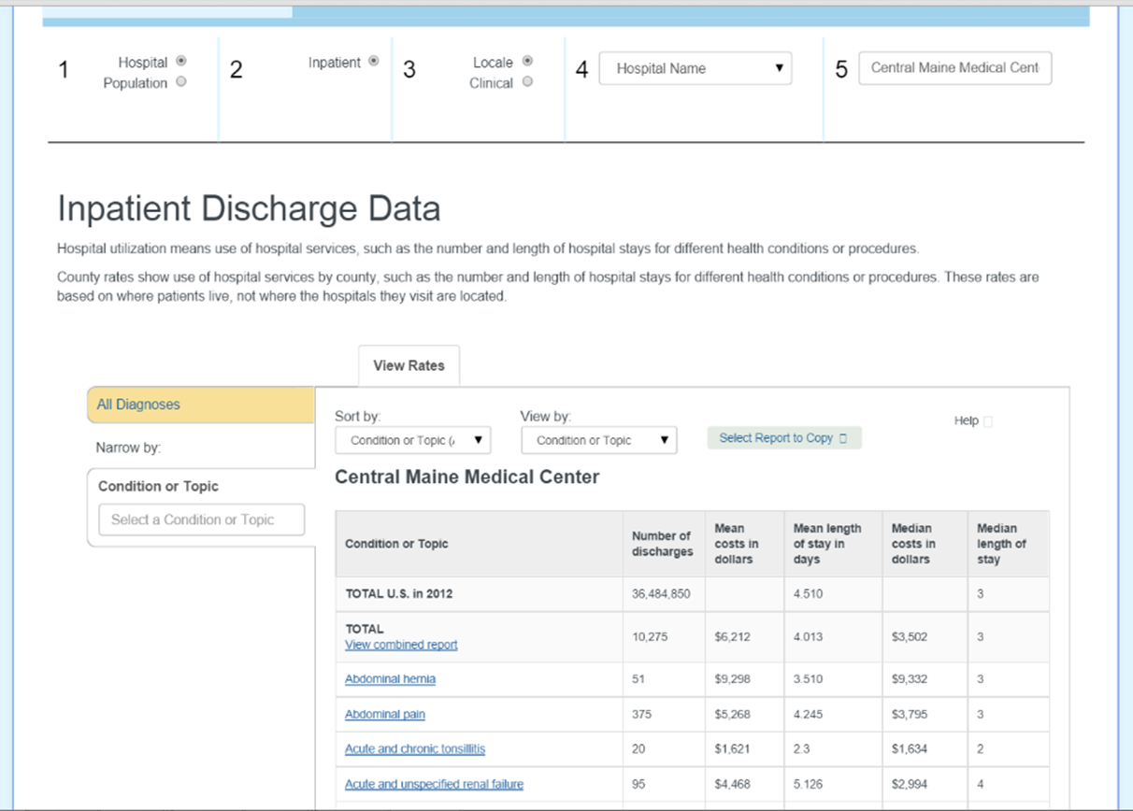
MONAHRQ 5.0-Hospital Utilization
  Currently no facility level discharge data is displayed on MONAHRQ 5.0
  Could display:
  Condition, Discharge, All Financial Data, Length of Stay
  Condition, Discharge, Charge Data, Length of Stay
  Condition, Discharge, Cost Data, Length Stay

Slide 53
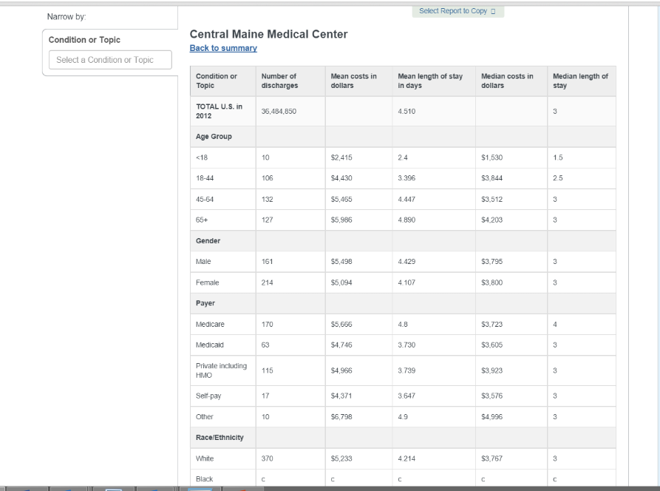
MONAHRQ 5.0-Hospital Detailed
  Could display:
  Discharge, financial, and LOS by:
  Age
  Gender
  Payer type
  Race/Ethnicity

Slide 54
MONAHRQ :
State Comparison of Data Elements Displayed
State | Hospital Utilization | Hospital Detail Utilization | Discharges | Charges | Costs | Length of Stay
Arizona | Yes | Yes | Yes | Yes | Yes | Yes
Texas | Yes | Yes | Yes | Yes | Yes | Yes
Virginia | Yes | Yes | Yes | Yes | Yes | Yes
Washington | Yes | Yes | Yes | Yes | Yes | Yes
Maryland | Yes | No | Yes | Yes | No | Yes
Maine | No | No | No | No | No | No
Nevada | Yes | Yes | Yes | Yes | No | Yes
Oklahoma | Yes | Yes | Yes | Yes | No | Yes
Utah | Yes | Yes | Yes | Yes | No | Yes
Kentucky | Yes | Yes | Yes | No | No | Yes

Slide 55
Pulling It All Together
  Review of HealthCompare Wireframes
  Questions
  Discuss Next Steps

Slide 56
Pulling It All Together
Review of HealthCompare Maine Wireframes
Focus Group Stakeholder Testing

Slide 57
Website Development:
Key Dates and Next Steps
Conduct Focus Groups | 3/13/2015 |  | Consumer Advisory Group Meeting | 7/10/2015
Consumer Advisory Group Meeting | 3/13/2015 |  | Conduct a prototype study | 7/15/2015
Review feedback from Focus Groups and CAG | 3/31/2015 |  | Present development website to Board | 7/16/2015
Finalize data displays, and secondary website pages | 4/8/2015 |  | Utilize feedback to refine the development website and content | 8/5/2015
Build website and conduct Quality Assurance Testing | 6/10/2015 |  | Final review and Quality Assurance of HealthCompare | 8/20/2015
Refine website based on testing and MHDO feedback | 6/30/2015 |  | Soft launch of HealthCompare | 8/21/2015
Finalize all HealthCompare Content | 6/30/2015 |  | Public launch of first release of HealthCompare | 9/30/2015

Slide 58
Recommendations
Board Discussion &
Next Steps

Slide 59
Recommendations/Discussion Items
Quality Data
  Display quality measures at the hospital level to indicate quality of physician groups and non-hospital facilities affiliated with hospitals.
MONAHRQ
  Display charge and cost information by hospital
  Display discharge, $ and LOS by hospital, age, gender, payer type, race/ethnicity
HealthCompare Maine Data Display
  Display the results by distance to facility if Zip Code is entered, if none, list alphabetical.
    Episode/Grouper Recommendation to Board this Spring

Slide 60

Public Comment

