Slide 1
Overview: Likely and Potential Users of Online Maine Health Care Cost Info
Elaine K. Swift, PhD
Sept. 12, 2014

Slide 2
What are Personas?
Fictional characters based on research on real users

Slide 3
Why Use Personas in Website Development?
Makes the characteristics of key audience segments less conceptual and more tangible
Builds understanding and empathy
Counteracts tendency to view website development from a personal perspective
Surfaces issues that might have otherwise been overlooked

Slide 4
Research Basis for Personas
Research on audiences for websites on health care information conducted for the Centers for Medicare & Medicaid Services (CMS):
Data Source: Nationally representative survey by Pew Internet and American Life Project, fielded August 7 to September 6, 2012.
Methodology: Standard k-means clustering analysis

Slide 5
Research Results
Results: Five audience segments of users of internet health information:
Two segments--Working Couples with Children and Higher Income Couples without Children—use both online health information and ratings.
Three segments--Middle-Aged, Sick, with Medicaid Coverage; Young, Low Income, and Uninsured; and Chronically Ill, with Medicare Coverage—use online health information but not ratings

Slide 6
About the Personas
Personas have fictional names, profiles, and health status
Each persona corresponds to one of the five segments identified through research. Health status developed with clinical input.

Slide 7
About the Personas (cont.)
Two personas are likely to use online health and health care info. They are more likely to be interested in cost info:
Sally the Shopper: Working Couples with Children
Cathy the Price Checker: Higher Income Couples without Children
Three personas are likely to use only health info only. They are potentially likely to be interested in cost info:
Patty the Patient: Middle-Aged, Sick, with Medicaid Coverage
Ian the Invincible: Young, Low Income, and Uninsured
Mary the Medicare Beneficiary: Chronically Ill, with Medicare Coverage

Slide 8
Patient Scenario 1: Sally the Shopper
Age: 41
City/Town: Portland
Family Status: Married, 2 children: boy (14), girl (10)
Home: Condo Owner
Income: $58,000 annual household income
Education: Associate’s Degree
Employment: Office Manager
Health Coverage: Insured through employer

Slide 9
Health Status
Husband’s Health: Asthma
Ventolin bronchodilator 3x day;
Advair aerosol 2x day for 2 weeks a month on average
Methylphenidate 54 mg 1x day
Sally and Daughter’s Health: Good
Son: ADHD

Slide 10
Patient Scenario 2: Cathy the Price Checker
Age: 54
City/Town: Augusta
Family Status: Married; Children living independently
Home: Home owner
Income: $80,000 annual household income
Education: Master’s Degree
Employment: Human Relations supervisor
Health Coverage: Insured through employer

Slide 11
Health Status
Osteopenia: Actonel (5 mg daily); Cholesterol: Zetia (10 mg daily)
Husband: rheumatoid arthritis (knee pain)
Cathy: osteopenia and high cholesterol
Voltaren (150 mg daily)

Slide 12
Patient Scenario 3: Patty the Patient
Age: 46
City/Town: Bangor
Marital Status: Divorced
Family: Daughter, 16
Home: Apartment
Income: $25,000
Education: GED
Employment: Unemployed
Health Coverage: Medicaid

Slide 13
Health Status
COPD: Treating with bronchodilator, inhaled steroids and theophylline
Type II Diabetes: Treating with metformin 1000 mg a day, 2x a day; glucophage (standing order); insulin.
Also requires related equipment and supplies (e.g., glucometer, swabs).
Patty’s Health Status: COPD, Type II Diabetes, Major Depressive Disorder
Daughter’s Health: Good
Major Depressive Disorder: Treating with Zoloft 40mg a day and
twice monthly therapy sessions

Slide 14
Patient Scenario 4: Ian the Invincible
Age: 28
City/Town: Rumford
Marital Status: Single
Family: No children
Home: Shared apartment
Income: $23,000
Education: High School
Employment: Logger
Health Coverage: Uninsured

Slide 15
Health Status
Good
Treated in Emergency Department following car accident.
Cast on foot; Dilaudid 4 mg 4x day, physical therapy

Slide 16
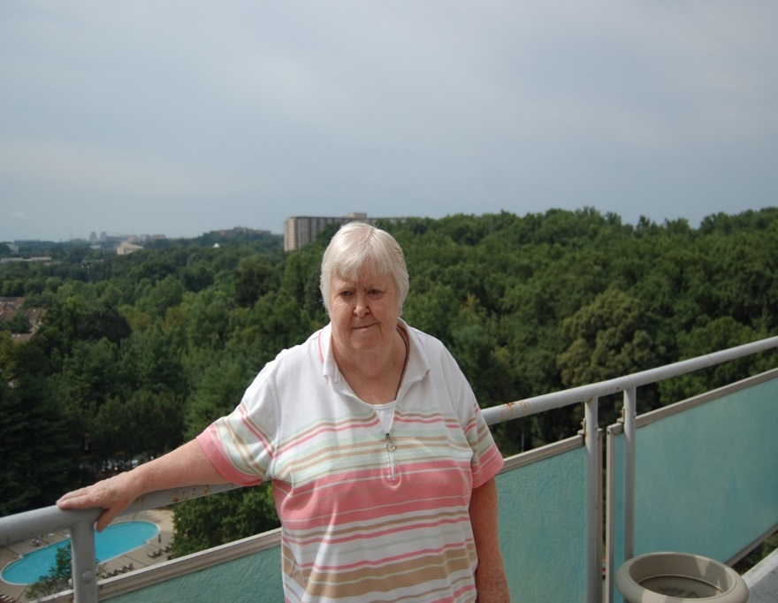
Patient Scenario 5: Mary the Medicare Beneficiary
Age: 75
City/Town: Van Buren
Family Status: Widowed; adult daughter lives in Boston
Home: Apartment
Income: Social Security; small pension
Education: Some college
Employment: Retired, retail salesperson
Health Coverage: Medicare A,B,D

Slide 17
Health Status
Cholesterol: Atorvastatin 80 mg 1x day. Osteoporosis: Evista, 60 mg, 1x day
Suffers massive AMI while alone in house; undergoes emergency triple bypass surgery
Released from hospital within 3 days
Former smoker, high cholesterol, osteoporosis
New medications: ACE inhibitor, lasix; beta blocker; calcium channel blocker; cardiac rehab within 10 weeks of surgery

