Slide 1

Payer User Group
Webinar – 12/11/2014

Slide 2
Agenda
Welcome (5 minutes)
  Opening Comments/Review Agenda
  Meeting Goals
Portal Implementation of Chapter 243 Changes (10 minutes)
  Status of Changes
  Tips and Helpful Hints
  Timeline for Annual Changes to Chapter 243 (5 minutes)
  Overview
  Registration and Validation Profile Updates (10 minutes)
  Updates to Form
  Validation Profile Resets
  Use Case Overview (15 minutes)
  High-level overview of different projects data users are working on using MHDO claims data
  Activities at MHDO (10 minutes)
  HealthCost
  Status of New Proposed Data Release Rule
  Q&A (10 minutes)

Slide 3
Meeting Goals
Review Portal Implementation of Chapter 243 Changes
Review Timeline for Future Chapter 243 Changes
Review Upcoming Registration and Profile Updates
Present Claims Data Use Cases
MHDO Updates

Slide 4
Chapter 243 Portal Implementation
  Payers began submitting data in the new Chapter 243 layout November 6.
  The transition has been a success due to payer participation in the September testing period.

Slide 5
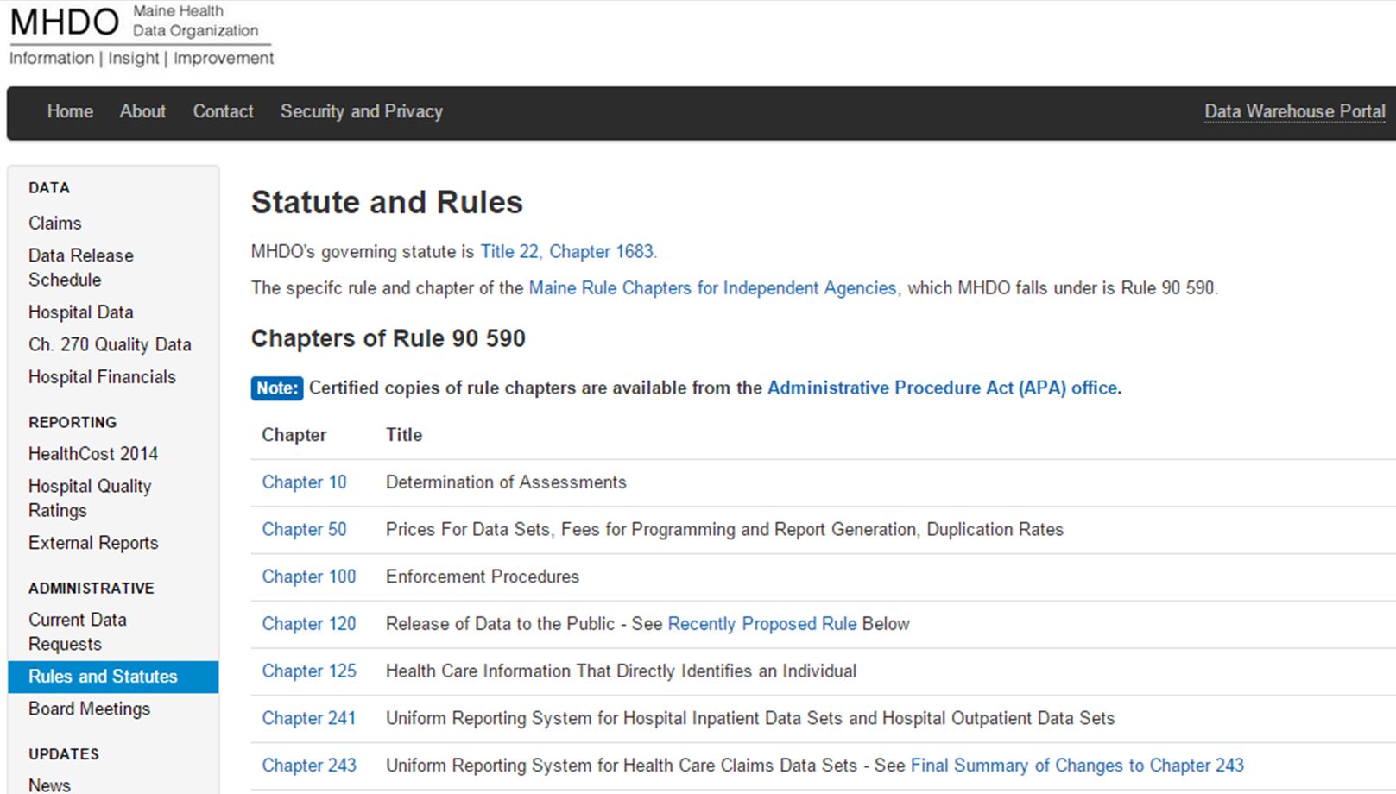
Chapter 243 Portal Implementation: Reminders
  All data submissions regardless of data period must be submitted in the new format.
  Information about the Chapter 243 changes can be found on the MHDO website https://mhdo.maine.gov/rules.htm

Slide 6

Chapter 243 Portal Implementation: Tips & Helpful Hints
  Population of 002 Fields
  The ME002, MC002, DC002, and PC002 are the Payer identification fields for each file.
  These fields need to be populated 100% of the time with the MHDO Assigned Code of the company that owns the book of business being submitted.
Populate Payer ID fields

Slide 7
Chapter 243 Portal Implementation: Tips & Helpful Hints
  Company A (C0099) is the insurer/underwriter/administrator of the coverage and they submit their own eligibility data.
  ME001: C0099
  ME002: C0099
  Company A (C0099) is the insurer/underwriter/administrator of the coverage. Company B (T0077) submits Company A’s eligibility data.
  ME001: T0077
  ME002: C0099

Slide 8
Chapter 243 Portal Implementation: Tips & Helpful Hints
  Population of PC047 and PC048
  Prescribing Physician DEA (PC047) and NPI (PC048) must be submitted in their appropriate fields.
  Exemptions will not be granted if NPIs have been submitted in PC047 or if DEAs have been submitted in PC048.
  Submitters must fix their files and resubmit to resolve the issue.

Slide 9

Chapter 243 Portal Implementation: Tips & Helpful Hints
  Submitting Older Data – Submission Period Locked Validation Issues
  Submission periods are locked for data periods already released to end users (data are released every quarter).
  When submitters try to submit data for a locked period, a Submission Period Locked structural validation issue occurs. This issue must be resolved before all other validation issues.
  If the data are less than a year old, the validation issue will be cleared as soon as the information is provided by the user. Submissions of data older than one year will require approval
  from MHDO before the issue will be cleared.

Slide 10

Portal Resources
  FAQs and User Manual
  HSRI maintains both FAQs and a User Manual with the latest information and questions. Each can be accessed in the Portal.
    FAQs https://mhdo.maine.gov/portal/Home/FAQ
    User Manual https://mhdo.maine.gov/portal/Home/UserManual
  Sample Files
  Sample files of the current file layout are available in the portal: https://mhdo.maine.gov/portal/Home/SampleFiles

Slide 11
Portal Resources
  Help Desk
  The Help Desk is available to answer technical questions related to portal submissions.
    Online: https://mhdo.maine.gov/portal/Home/Contact
    Email: mhdohelp@norc.org
    Phone: (866) 315-7125
  Compliance Issues
  For compliance related issues contact:
  Philippe Bonneau, Compliance Officer, Maine Health Data Organization
  Email: philippe.bonneau@maine.gov
  Phone: (207) 287-6743

Slide 12
Timeline for Annual Changes to Chapter 243
  Changes will be made no more than annually, unless there is a change in federal law.
  The goal is for changes to occur on the same schedule every year.

Slide 13
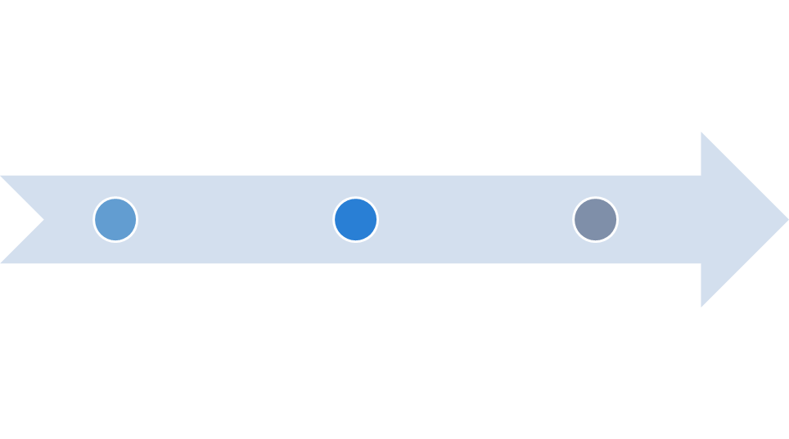
Timeline
Timeframe | Task
January - February | Vet Proposed Rule Change(s) with Payers
March | Present Proposed Rule Change(s) to MHDO Board of Directors
May | Public Hearing on Proposed Rule Change
July | MHDO Board Approves Adoption of Rule
January | Changes go into Effect (beginning with the submission of January data)
Note: The above is a high level overview of the key steps in the process and the anticipated timeline-subject to change as the process unfolds.

Slide 14
Registration Updates
  Updates to Registration Information
  All portal registration information needs to be reviewed and updated annually.
  This will occur for the first time in the Portal in February 2015. MHDO is considering the addition of a few questions.
Update registration
info

Slide 15
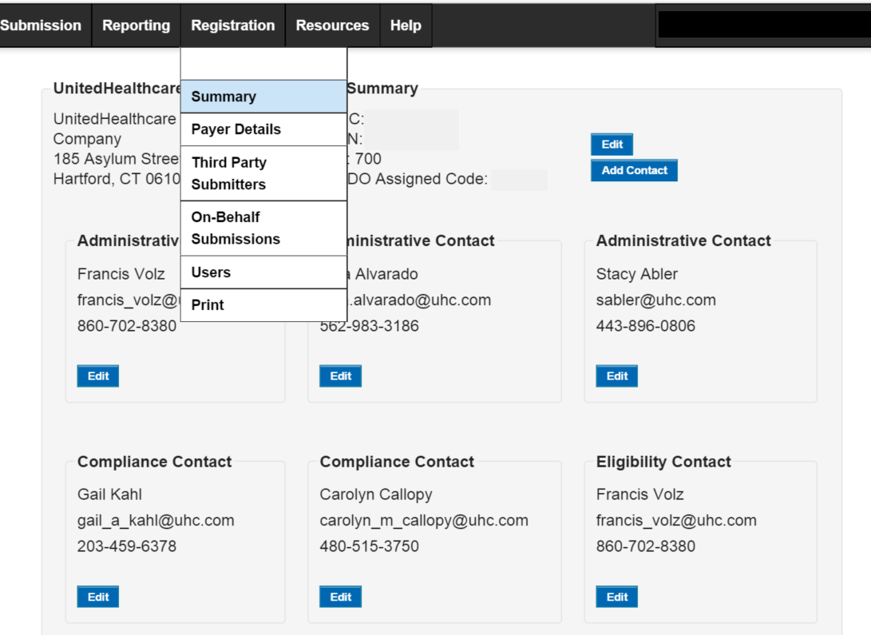
Registration Updates: Summary

Slide 16
Registration Updates: Payer Details
  Company Business
  Does the company conduct business for 200 or more Maine-resident members for every month during a calendar year and for $500,000 or more worth of adjusted premiums or claims processed per calendar year?
  Please select all the types of claims your company will be submitting or will be submitted on your behalf and specify coverage details as appropriate.
  Monthly Medical Claims Details
  Enter the minimum monthly total of Maine-resident members for whom medical claims are being paid.
  Enter the number of Medicare Part C Maine covered lives for one month

Slide 17
Registration Updates: Payer Details
  Monthly Pharmacy Claims Details
  Enter the number of Medicare Part C Maine covered lives for one month.
  Enter the number of Medicare Part D Maine covered lives for one month.
  Enter the minimum monthly total of Maine-resident members for whom pharmacy claims are being paid.
  Monthly Dental Claims Details
  Enter the minimum monthly total of Maine-resident members for whom dental claims are being paid.

Slide 18
Validation Profile Updates
  Annual Profile and Exemption Resets
  All existing profile and exemption-level overrides will expire as of February 1, 2015. Submissions that occur after this reset (January 2015 data) will be evaluated against all validation rules.
  New profile and exemption-level overrides will have to be requested as needed.
Submit new override
requests

Slide 19
Validation Update: City Name Validation
  Starting with January 2015 data, we will no longer validate a City Name where there is a valid Zip Code.
  City Names will only be validated against a threshold where there is not a valid Zip Code.
  This adjustment will impact the validation of all city name fields. (ME015, DC014, DC027, MC014, MC033, MC082, MC089, PC014, PC022)

Slide 20
Use Case Overview
  Introduction
  Judy Loren, Senior Researcher
  Maine Health Management Coalition

Slide 21
The APCD’s Role in Achieving the Triple Aim
Judy Loren
Senior Researcher

Slide 22
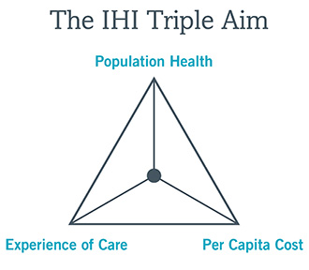
Triple Aim

Slide 23
The APCD Difference
The only source of complete utilization and cost information for each patient.
  Across provider systems
  Across plans
  Across time
Measures process quality
Merge with clinical to get outcome quality
Indirectly supports patient satisfaction

Slide 24
MHDO Super Users Group
Public sector
  Maine CDC, USM Muskie School of Public Service
Private sector
  MaineHealth, MHMC, Onpoint Health Data, SAS, NNEACC
Other States
  Vermont, New Hampshire, Virginia

Slide 25
PCMH Evaluation
Purpose: Does the PCMH model work?
  Quality
  Efficiency
Scope
  Comparison over time
  Comparison with control group
Impact:
  Multiple payers involved
  Funded by MaineCare, Quality Counts, MQF
  Entire state

Slide 26
Practice Reports
Purpose: Individual practice operations review
  Quality
  Efficiency
Scope
  Total cost/utilization for each patient
  Comparison with benchmarks
Impact:
  Every primary care practice in the state
  Multiple funders, multiple producers
  Annual, since 2010

Slide 27
Worksite Wellness
Purpose: Does this wellness program reduce medical cost?
  Medical and pharmacy costs (ROI)
Scope
  Comparison with control group
Impact:
  Continuation/modification of program for one employer
  Potential for expansion of program

Slide 28
Provider System Improvement
Purpose: Manage the total cost of care
  Across the area serviced by the system
Scope
  Measure variation
  Research contributing factors
Impact:
  Provider systems accepting risk/global payments
Requires meaningful rendering and servicing provider identification

Slide 29
Practice Improvement
Purpose: Reduce cost, improve outcomes
  Specific to orthopedic procedures
Scope
  Measure cost at specific stages of procedure
  Compare one practice with all others
Impact:
  Individual practice can assess effectiveness of specific strategies such as extended PT

Slide 30
Payment Reform
Purpose: Assess payment reform proposal
  Specific to oncology
Scope
  Measure cost at specific stages of illness
  Timing relative to initial chemotherapy
Impact:
  Immediate: changes to proposal
  Long-term: aligned incentives, reduced cost

Slide 31
Managing Specific Conditions
Purpose: Reduce inpatient utilization
  Develop initiatives targeted at common causes
Scope
  Measure utilization and cost
  Detect patterns by condition
Impact:
  Improve health
  Reduce cost

Slide 32
Resource Allocation
Purpose: Control costs, improve access
  Place resources strategically
Scope
  Measure utilization patterns by geography
  Analyze referral patterns from primary to specialty care
Impact:
  Reduce investment in high value equipment
  Locate primary care services
  Improve care coordination

Slide 33
National TCOC
Purpose: National comparison
  Develop reference points to assess regional cost of care
  Risk-adjusted
Scope
  Measure utilization and cost
  Standardize populations
Impact:
  Multi-level
Need comparable information on cost for all regions.

Slide 34
Aligning Forces for Quality
Purpose: Determine whether goals were achieved
  Measure performance of participating practices to determine whether goals were met
Scope
  Measure utilization, cost and quality
  Specific areas such as Ambulatory Care Sensitive ED visits, readmissions
Impact:
  Brought in over $4 million
  Helped support the PCMH
  Helped prepare Maine for the State Innovation Model grant

Slide 35
Activities at MHDO
HealthCost (mhdo.maine.gov/healthcost2014)
  Improving methodology
  Incorporating quality data
  Improving website design and usability
  Increasing the number of links to payers cost calculators on the resource page
  Working with a Consumer Advisory Group
  Launch of new website in September 2015

Slide 36

HealthCost

Slide 37
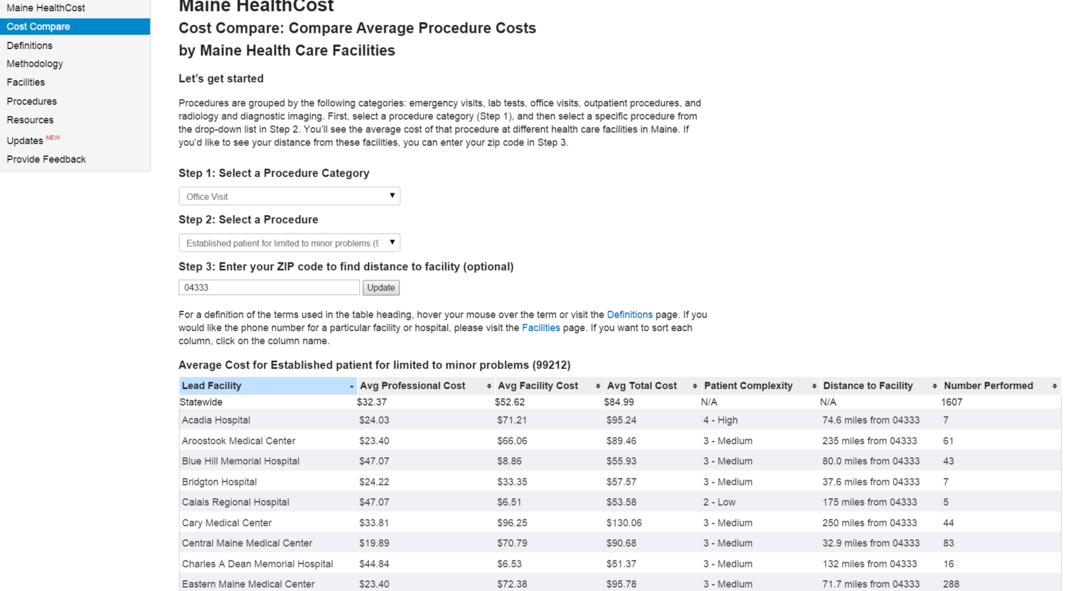
HealthCost

Slide 38
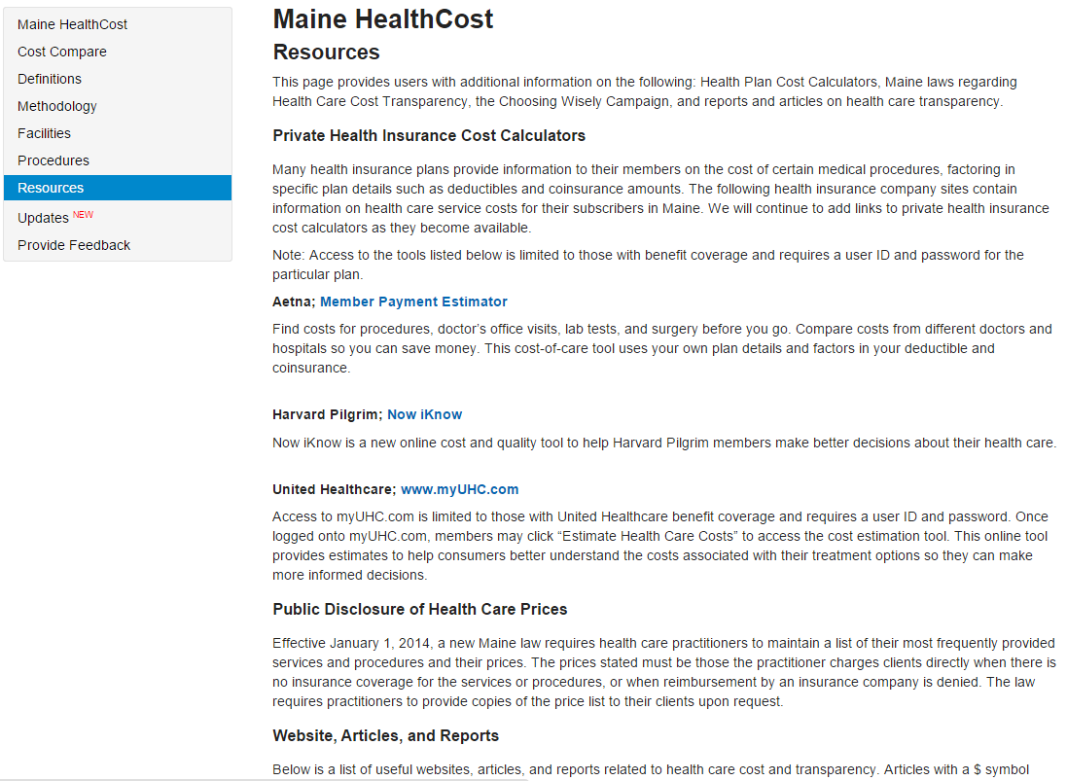
HealthCost

Slide 39
Activities at MHDO
Status of new proposed data release rule (Chapter 120)
  Public Hearing - December 18, 2014
  Deadline for Public Comments - December 29, 2014
  Proposed rule can be found here: https://mhdo.maine.gov/rules.htm#recentlyproposed

Slide 40

Questions? mhdo.maine.gov or
Philippe Bonneau Philippe.Bonneau@maine.gov
(207) 287-6743

